Slide 1



2150703
Analysis and Design of Algorithms (ADA)
2150703
Analysis and Design of Algorithms (ADA)
Unit-2
Analysis of Algorithms
Unit-2
Analysis of Algorithms
Dr. Gopi Sanghani
9825621471
gopi.sanghani@darshan.ac.in

Slide 2
Topics to be covered
Analysis of Algorithm
The efficient algorithm
Average, Best and Worst case analysis
Asymptotic Notations
Analyzing control statement
Sorting Algorithms and analysis: Bubble sort, Selection sort, Insertion sort, Shell sort and Heap sort
Sorting in linear time : Bucket sort, Radix sort and Counting sort
Amortized analysis

Slide 3
Analysis of Algorithm

Slide 4
Analysis of Algorithm
What is the analysis of an algorithm?
Analyzing an algorithm means calculating/predicting the resources that the algorithm requires.
Two most important resources are computing time (time complexity) and storage space (space complexity).
Why analysis is required?
By analyzing some of the candidate algorithms for a problem, the most efficient one can be easily identified.

Slide 5
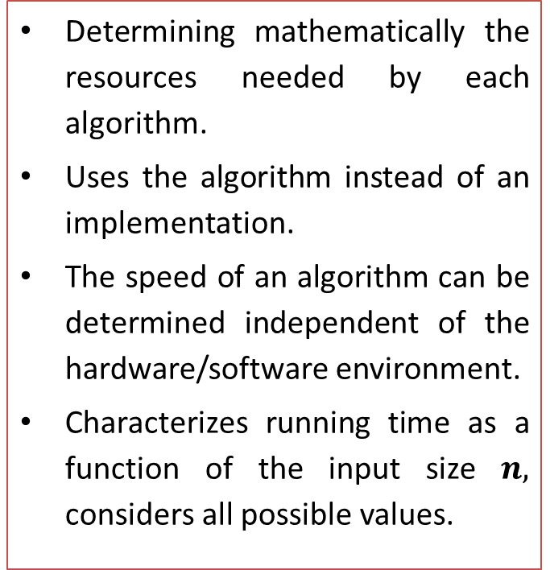
How Analysis is Done?
Empirical (posteriori) approach
Theoretical (priori) approach
Programming different competing techniques & running them on various inputs using computer.
Implementation of different techniques may be difficult.
The same hardware and software environments must be used for comparing two algorithms.
Results may not be indicative of the running time on other inputs not included in the experiment.
Determining mathematically the resources needed by each algorithm.
Uses the algorithm instead of an implementation.
The speed of an algorithm can be determined independent of the hardware/software environment.
Characterizes running time as a function of the input size $n,$ considers all possible values.
5

Slide 6
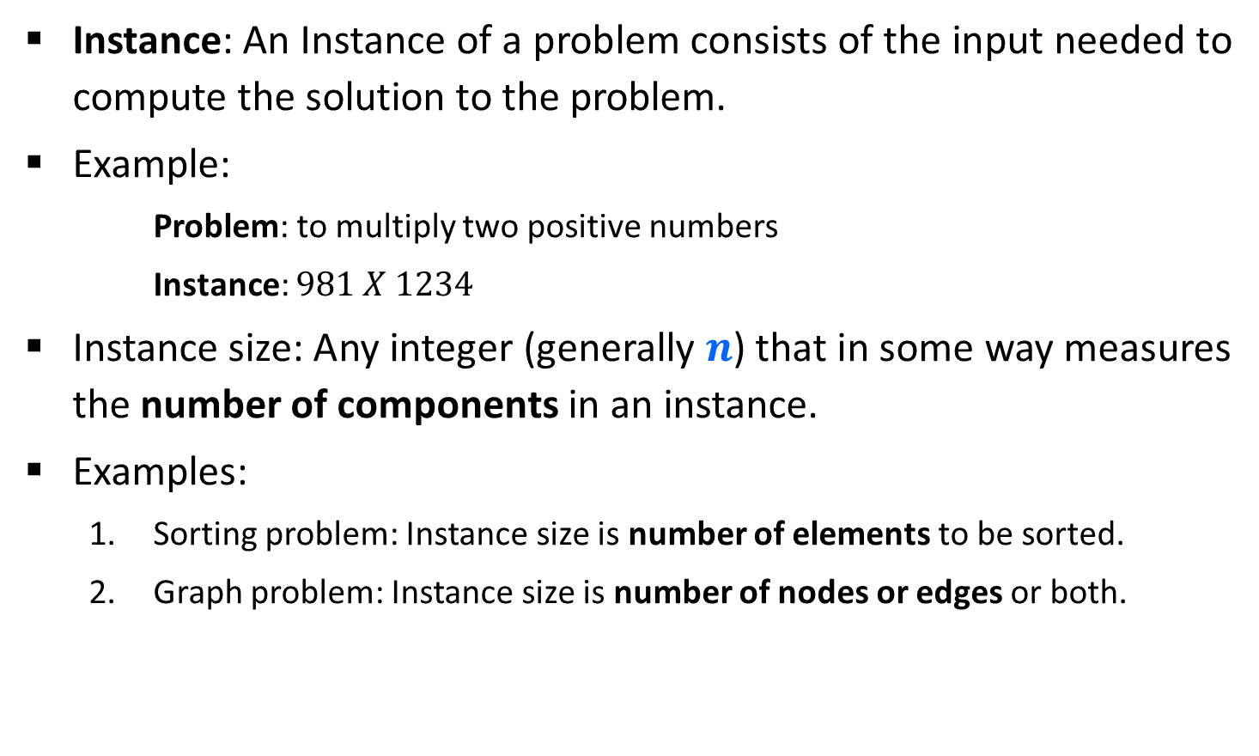
Problem & Instance
Instance: An Instance of a problem consists of the input needed to compute the solution to the problem.
Example:
Problem: to multiply two positive numbers
Instance: $981 X 1234$
Instance size: Any integer (generally $n$) that in some way measures the number of components in an instance.
Examples:
Sorting problem: Instance size is number of elements to be sorted.
Graph problem: Instance size is number of nodes or edges or both.

Slide 7
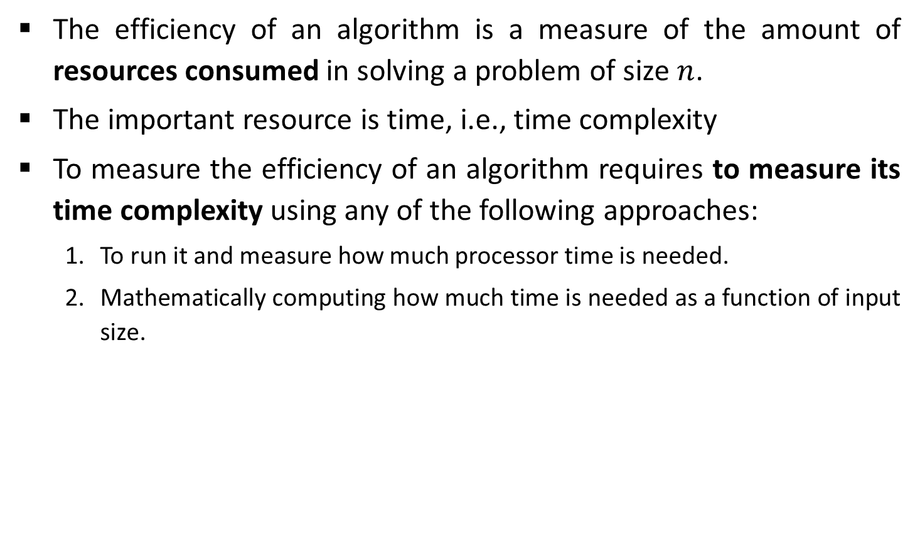
Efficiency of Algorithm
The efficiency of an algorithm is a measure of the amount of resources consumed in solving a problem of size $n$.
The important resource is time, i.e., time complexity
To measure the efficiency of an algorithm requires to measure its time complexity using any of the following approaches:
To run it and measure how much processor time is needed.
Mathematically computing how much time is needed as a function of input size.
Empirical Approach
Theoretical Approach

Slide 8
Efficiency of Algorithm
Running time of an algorithm depends upon,
Input Size
Nature of Input
Generally time grows with the size of input, for example, sorting 100 numbers will take less time than sorting of 10,000 numbers.
So, running time of an algorithm is usually measured as a function of input size.
In theoretical computation of time complexity, Running time is measured in terms of number of steps/primitive operations performed.

Slide 9

Linear Search
Suppose, you are given a jar containing some business cards.
You are asked to determine whether the name “Mukesh Ambani" is in the jar.
To do this, you decide to simply go through all the cards one by one.
How long this takes?
Can be determined by how many cards are in the jar, i.e., Size of Input.

Slide 10
Linear Search
Linear search is a method for finding a particular value from the given list.
The algorithm checks each element, one at a time and in sequence, until the desired element is found.
Linear search is the simplest search algorithm.
It is a special case of brute-force search.

Slide 11
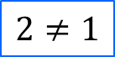
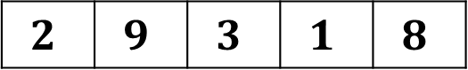


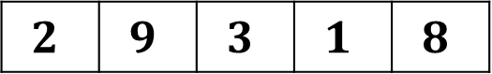
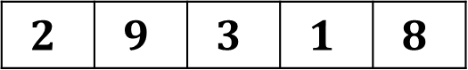

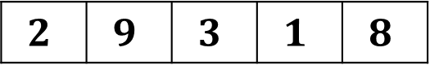
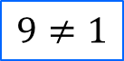
Linear Search - Example
Search for $1$ in given array
$$2$$ | $$9$$ | $$3$$ | $$1$$ | $$8$$
Comparing value of i^{th} index with the given element one by one, until we get the required element or end of the array
Step 1: i=0
Step 3: i=2
$$2$$ | $$9$$ | $$3$$ | $$1$$ | $$8$$
$$2$$ | $$9$$ | $$3$$ | $$1$$ | $$8$$
i
i
$$2≠1$$
$$3≠1$$
Step 2: i=1
Step 4: i=3
$$2$$ | $$9$$ | $$3$$ | $$1$$ | $$8$$
$$2$$ | $$9$$ | $$3$$ | $$1$$ | $$8$$
$$1$$
i
i
$$9≠1$$
Element found at i^{th} index, i=3

Slide 12
Linear Search Algorithm
# Input : Array A, element
# Output : First index of element in A or
-1 if not found
Algorithm: Linear_Search
for i = 1 to last index of A:
if A[i] equals element:
return i
return -1

Slide 13
Linear Search
The required element in the given array can be found at,
E.g. 2: It is at the first position
Best Case: minimum comparison is required
E.g. 3 or 1: Anywhere after the first position
Average Case: average number of comparison is required
E.g. 8 or 7: Last position or does not found at all
Worst Case: maximum comparison is required
Worst Case
2
2 | 9 | 3 | 1 | 8
Best Case
Average Case

Slide 14
Analysis of Algorithm
Best case | Average case | Worst case
Resource usage is minimum | Resource usage is average | Resource usage is maximum
Algorithm’s behavior under optimal condition | Algorithm’s behavior under random condition | Algorithm’s behavior under the worst condition
Minimum number of steps or operations | Average number of steps or operations | Maximum number of steps or operations
Lower bound on running time | Average bound on running time | Upper bound on running time
Generally do not occur in real | Average and worst-case performances are the most used in algorithm analysis.

Slide 15
Asymptotic Notations

Slide 16
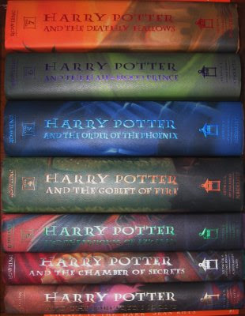
Book Finder
Suppose, you are writing a program to find a book from the shelf.
For any required book, it will start checking books one by one from the bottom.
If you wanted Harry Potter 3, it would only take 3 actions (or tries) because it’s the third book in the sequence.
If Harry Potter 7 — it’s the last book so it would have to check all 7 books.
What if there are total 10 books? How about 10,00,000 books? It would take 1 million tries.

Slide 17
Number Sorting
Suppose you are sorting numbers in Ascending / Increasing order.
The initial arrangement of given numbers can be in any of the following three orders.
Numbers are already in required order, i.e., Ascending order
No change is required – Best Case
Numbers are randomly arranged initially.
Some numbers will change their position – Average Case
Numbers are initially arranged in Descending or Decreasing order.
All numbers will change their position – Worst Case
5 | 9 | 12 | 23 | 32 | 41
9 | 5 | 12 | 32 | 23 | 41
5 | 9 | 12 | 23 | 32 | 41
41 | 32 | 23 | 12 | 9 | 5

Slide 18
Best, Average, & Worst Case
Problem
Linear Search
Book Finder
Sorting
Best Case
Average Case
Worst Case
Element at the first position | Element in any of the middle positions | Element at last position or not present
The first book | Any book in-between | The last book
Already sorted | Randomly arranged | Sorted in reverse order

Slide 19
Bounds on Running Time
Lower Bound: A lower bound L(n) of an algorithm defines the minimum time required, it is not possible to have any other algorithm (for the same problem) whose time complexity is less than L(n) for random input.
Upper Bound: An upper bound U(n) of an algorithm defines the maximum time required, we can always solve the problem in at most U(n) time. Time taken by a known algorithm to solve a problem with worse case input gives the upper bound.

Slide 20
Asymptotic Notations
Asymptotic Notations (Big O, θ - Theta and Ω - Omega) allow us to analyze an algorithm’s running time.
This is also known as an algorithm’s growth rate.
Asymptotic Notations are used,
To characterize the complexity of an algorithm.
To compare the performance of two or more algorithms solving the same problem.

Slide 21
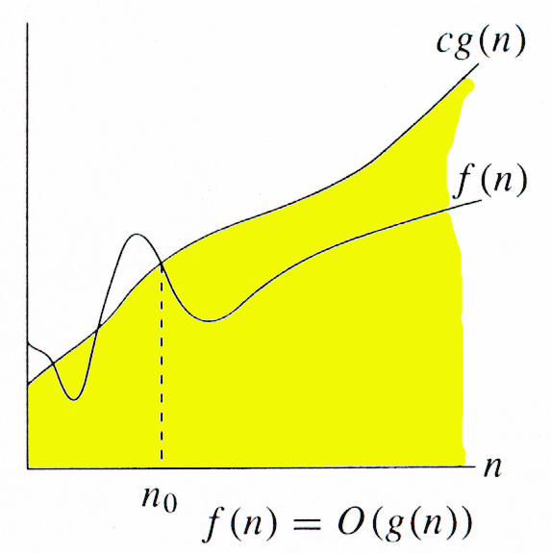
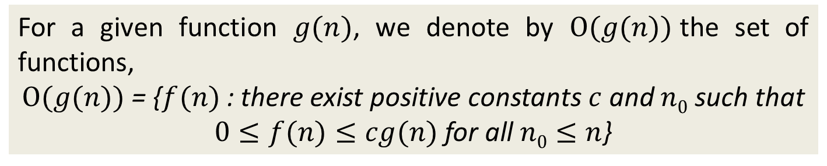
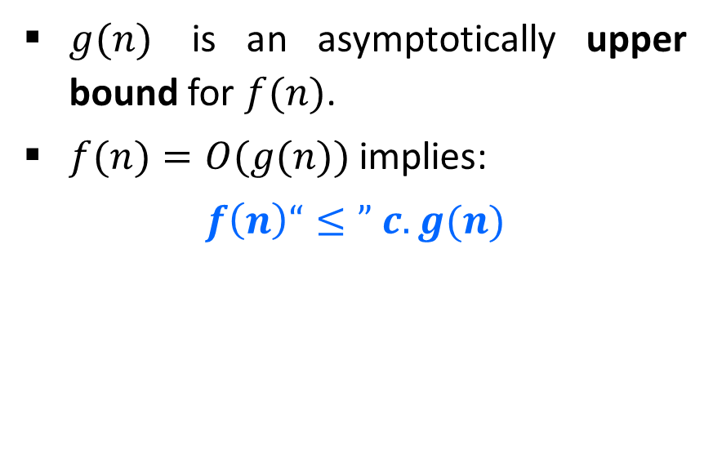
O-Notation (Big O notation) (Upper Bound)
For a given function $g(n)$, we denote by $Ο(g(n))$the set of functions,
$Ο(g(n))$= {$f(n)$ : there exist positive constants $c$ and $n0$ such that
$0≤f(n)≤cg(n)$for all $n0≤n$}
$g(n)$ is an asymptotically upper bound for $f(n)$.
$f(n)=O(g(n))$implies:
$$f\left(n\right)“≤” c.g(n)$$

Slide 22
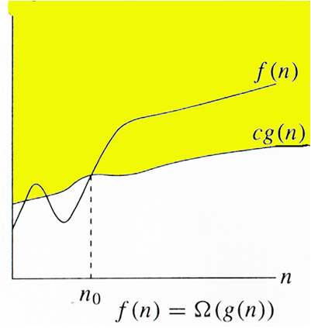
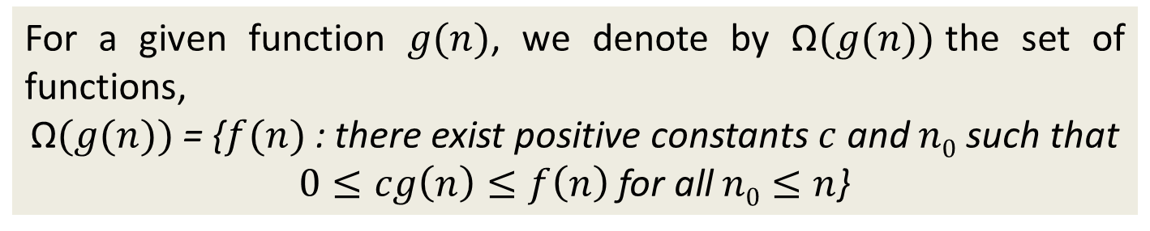
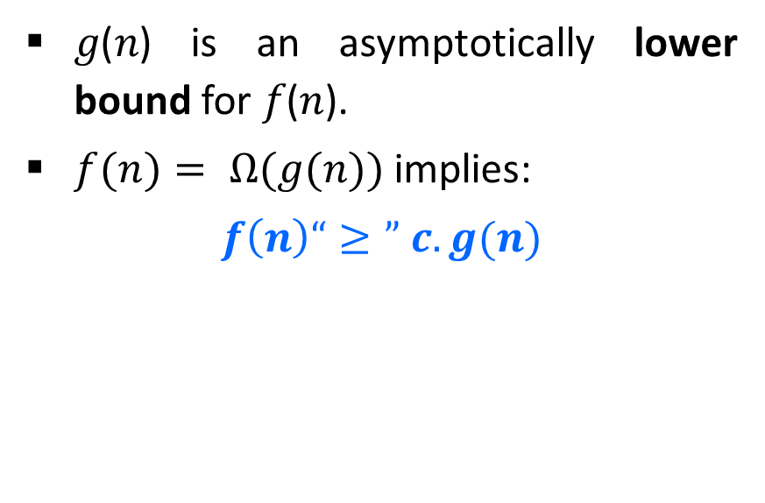
Ω-Notation (Omega notation) (Lower Bound)
For a given function $g(n)$, we denote by Ω$(g(n))$the set of functions,
$\text{Ω}(g(n))$= {$f(n)$ : there exist positive constants $c$ and $n0$ such that
$0≤cg\left(n\right)≤f\left(n\right)$for all$n0≤n$}
𝑔(𝑛) is an asymptotically lower bound for 𝑓(𝑛).
$f(n)= Ω(g(n))$implies:
$$f\left(n\right)“≥” c.g(n)$$

Slide 23
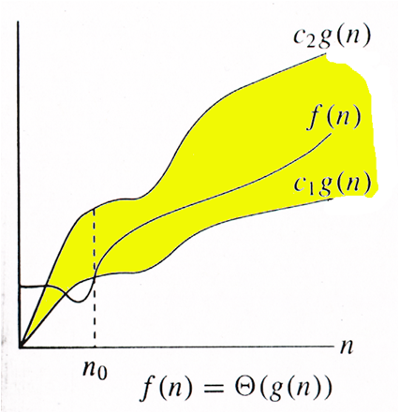
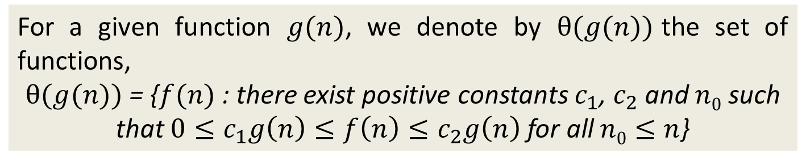
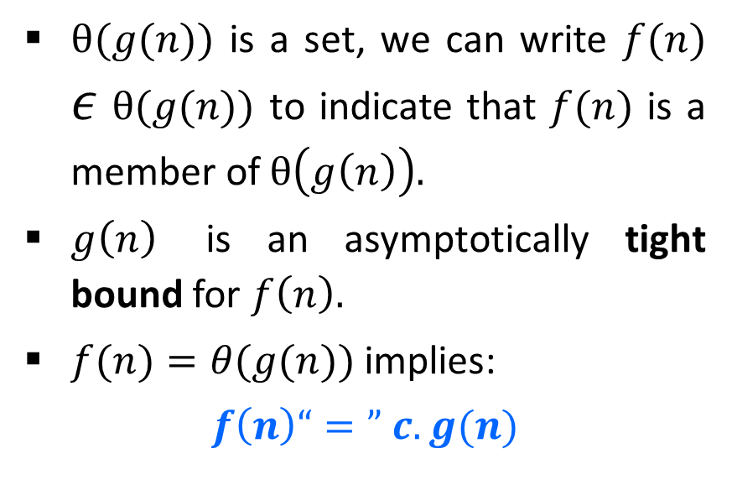
θ-Notation (Theta notation) (Same order)
For a given function $g(n)$, we denote by $θ(g(n))$the set of functions,
$θ(g(n))$ = {$f(n)$ : there exist positive constants $c_{1}$, $c_{2}$ and $n0$ such that $0≤c_{1}g\left(n\right)≤f\left(n\right)≤c_{2}g\left(n\right)$ for all$n0≤n$}
$θ(g(n))$ is a set, we can write $f(n)$ $ε$ $θ(g(n))$ to indicate that $f(n)$ is a member of $θ\left(g\left(n\right)\right).$
$g\left(n\right)$ is an asymptotically tight bound for $f\left(n\right).$
$f(n)=θ(g(n))$implies:
$$f\left(n\right)“=” c.g(n)$$

Slide 24
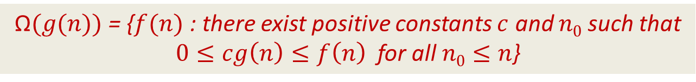
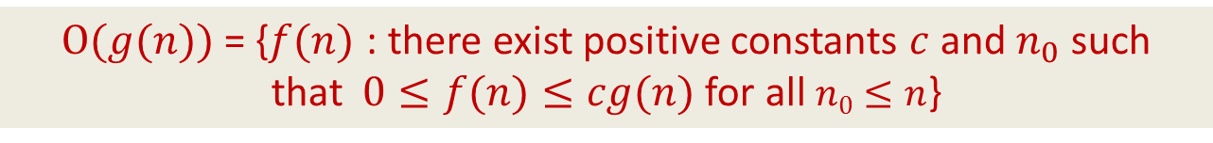
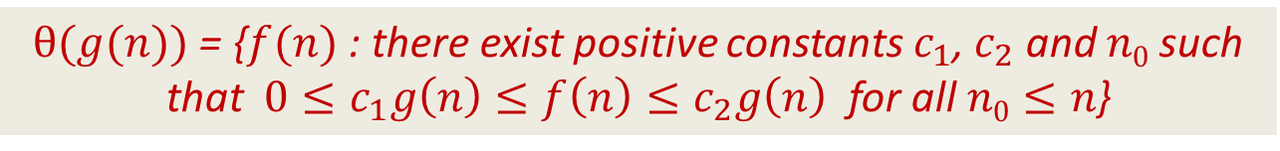
Asymptotic Notations
O-Notation (Big O notation) (Upper Bound)
Ω-Notation (Omega notation) (Lower Bound)
θ-Notation (Theta notation) (Same order)
$Ο(g(n))$= {$f(n)$ : there exist positive constants $c$ and${ n}_{0}$ such that$0≤f(n)≤cg(n)$for all$n0≤n$}
$\text{Ω}(g(n))$= {$f(n)$ : there exist positive constants $c$ and $n0$ such that
$0≤cg\left(n\right)≤f\left(n\right)$ for all$n0≤n$}
$θ(g(n))$ = {$f(n)$ : there exist positive constants $c_{1}$, $c_{2}$ and $n0$ such that $0≤c_{1}g\left(n\right)≤f\left(n\right)≤c_{2}g\left(n\right)$ for all$n0≤n$}

Slide 25



Asymptotic Notations
$$f(n)=O(g(n))$$
$Ο(g(n))$= {$f(n)$ : there exist positive constants $c$ and${ n}_{0}$ such that$0≤f(n)≤cg(n)$for all$n0≤n$}
$$f(n)=\text{Ω}(g(n))$$
$\text{Ω}(g(n))$= {$f(n)$ : there exist positive constants $c$ and $n0$ such that
$0≤cg\left(n\right)≤f\left(n\right)$ for all$n0≤n$}
$$f(n)=θ(g(n))$$
$θ(g(n))$ = {$f(n)$ : there exist positive constants $c_{1}$, $c_{2}$ and $n0$ such that $0≤c_{1}g\left(n\right)≤f\left(n\right)≤c_{2}g\left(n\right)$ for all$n0≤n$}

Slide 26
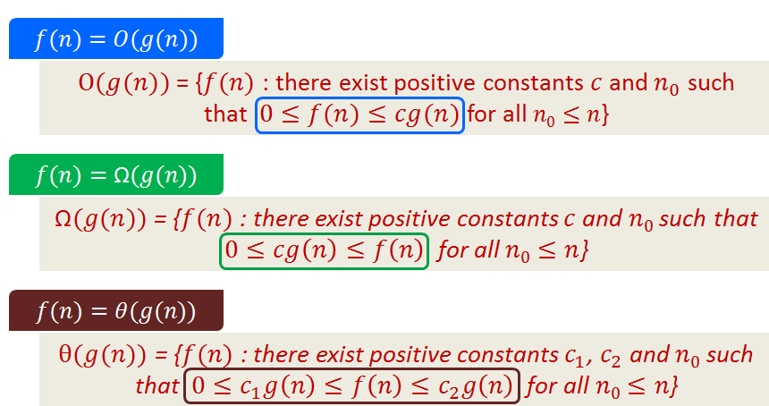
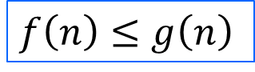
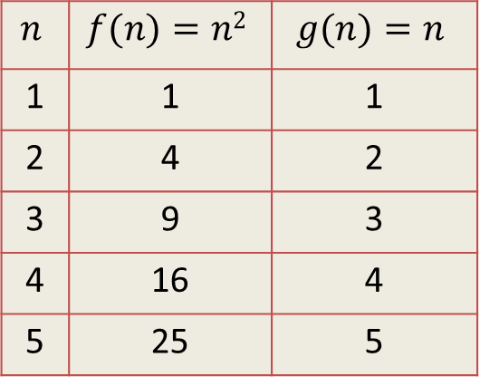
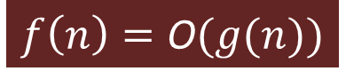
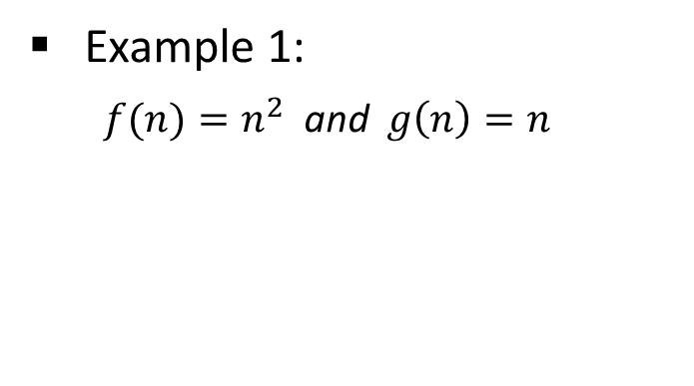
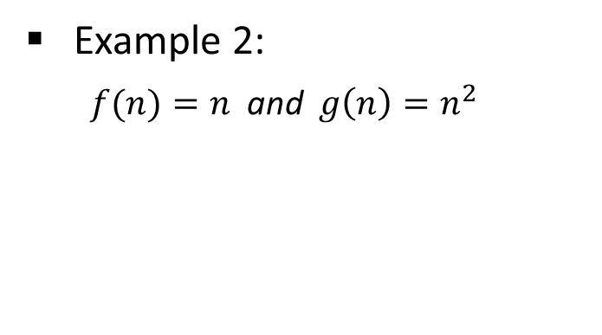

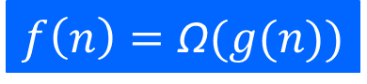
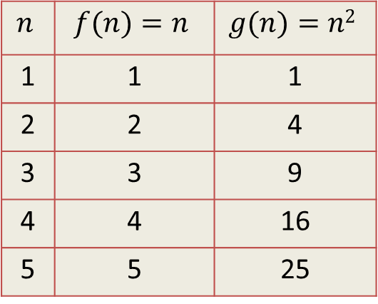
Asymptotic Notations - Example
Example 1:
$f(n)=n^{2}$ and $g\left(n\right)=n$
Example 2:
$f(n)=n$ and $g\left(n\right)=n^{2}$
Algo. 1 running time
Algo. 2 running time
Algo. 1 running time
Algo. 2 running time
$$f\left(n\right)≥g\left(n\right)$$
$$f\left(n\right)=\text{Ω}(g(n))$$
$$f\left(n\right)≤g\left(n\right)$$
$$f\left(n\right)=\text{O}(g(n))$$
$$n$$ | $$f(n)=n2$$ | $$g(n)=n$$
1 | 1 | 1
2 | 4 | 2
3 | 9 | 3
4 | 16 | 4
5 | 25 | 5
$$n$$ | $$f(n)=n$$ | $$g(n)=n2$$
1 | 1 | 1
2 | 2 | 4
3 | 3 | 9
4 | 4 | 16
5 | 5 | 25

Slide 27
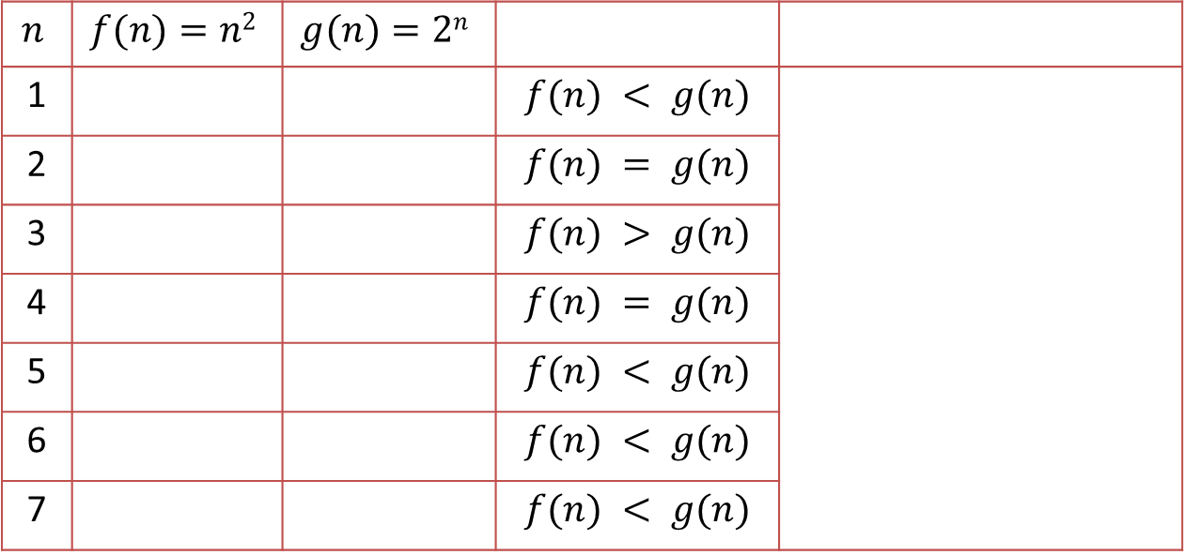
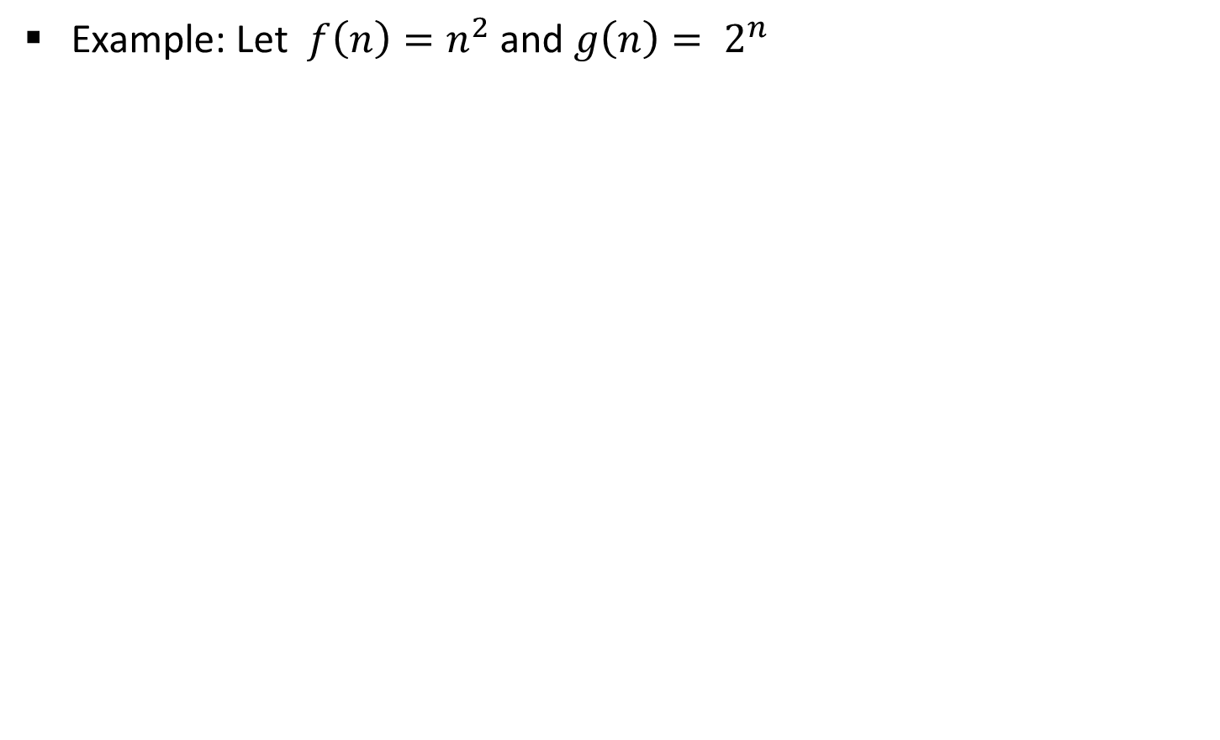
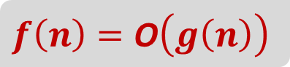
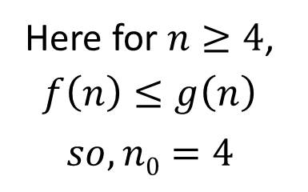
Asymptotic Notations - Example
Example: Let $f\left(n\right)=n^{2}$ and $g\left(n\right)= 2^{n}$
$$f\left(n\right)=\text{O}\left(g\left(n\right)\right)$$
Algo. 1 running time
Algo. 2 running time
$$n$$ | $$f(n)=n2$$ | $$g(n)=2n$$
1 |  |  | $$f(n) < g(n)$$
2 |  |  | $$f(n) = g(n)$$
3 |  |  | $$f(n) > g(n)$$
4 |  |  | $$f(n) = g(n)$$
5 |  |  | $$f(n) < g(n)$$
6 |  |  | $$f(n) < g(n)$$
7 |  |  | $$f(n) < g(n)$$
1
2
4
4
9
8
16
16
Here for $n≥4$, $f\left(n\right)≤g\left(n\right)$
$$so, n0=4$$
25
32
36
64
49
128

Slide 28
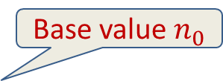
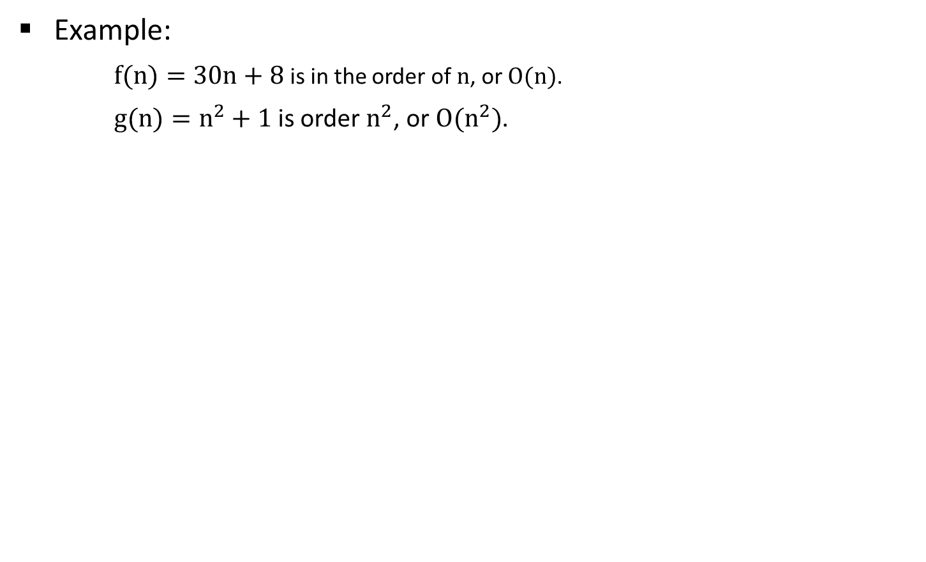
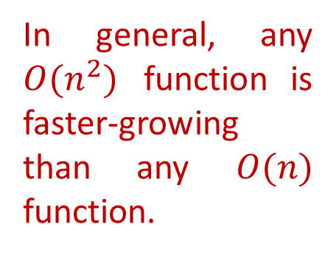
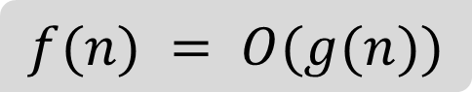
Asymptotic Notations - Example
Example:
$f(n)=30n+8$is in the order of $n$, or $O(n)$.
$g(n)=n^{2}+1$is order $n^{2}$, or $O(n^{2})$.
$$f(n) = O(g(n))$$
g (n)=n²+1
f(n)=30n+8
In general, any $O(n^{2})$ function is faster-growing than any $O(n)$ function.
Value of function →
Base value $n_{0}$
Increasing n →

Slide 29
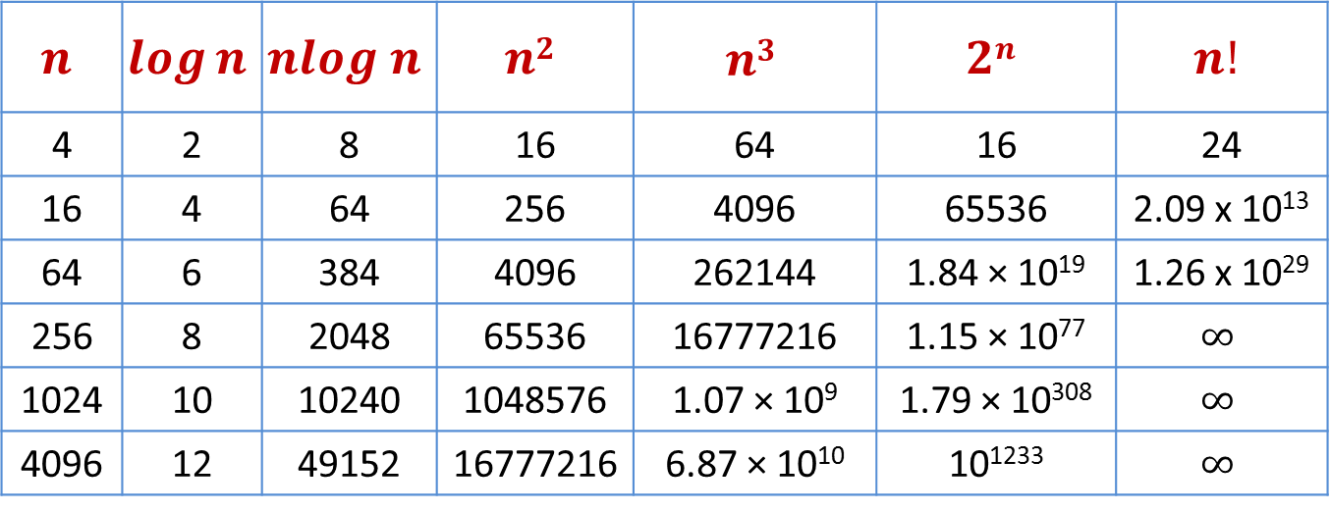
Common Orders of Magnitude
$$n$$ | $$\log{n}$$ | $$nlog n$$ | $$n2$$ | $$n3$$ | $$2n$$ | $$n!$$
4 | 2 | 8 | 16 | 64 | 16 | 24
16 | 4 | 64 | 256 | 4096 | 65536 | 2.09 x 10¹³
64 | 6 | 384 | 4096 | 262144 | 1.84 × 10¹⁹ | 1.26 x 10²⁹
256 | 8 | 2048 | 65536 | 16777216 | 1.15 × 10⁷⁷ | $$∞$$
1024 | 10 | 10240 | 1048576 | 1.07 × 10⁹ | 1.79 × 10³⁰⁸ | $$∞$$
4096 | 12 | 49152 | 16777216 | 6.87 × 10¹⁰ | 10¹²³³ | $$∞$$

Slide 30
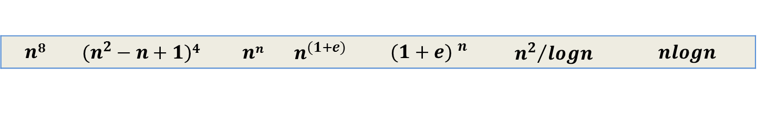
Growth of Function (HW)
Arrange the given notations in the increasing order of their values.
1
$$n$$ | $$nlogn$$ | $$2n$$ | $$logn$$ | $$\sqrt{n}$$ | $$en$$ | $$n2+logn$$ | $$n2$$ | $$loglogn$$ | $$n3$$ | $$(logn)2$$ | $$n!$$
2
$$n8$$ | $$(n^{2}−n+1)4{}^{}$$ | $$nn$$ | $$n^{(1+e)}$$ | $${(1+e) }^{n}$$ | $${n^{2}}/{logn}$$ | $$nlogn$$

Slide 31
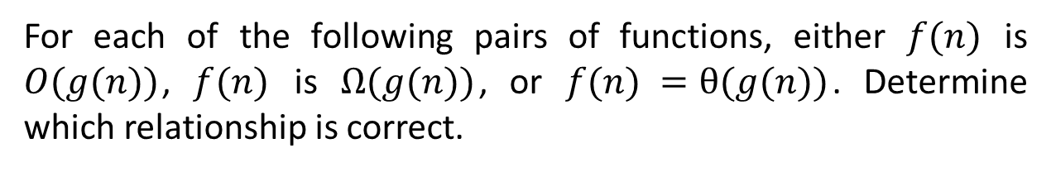
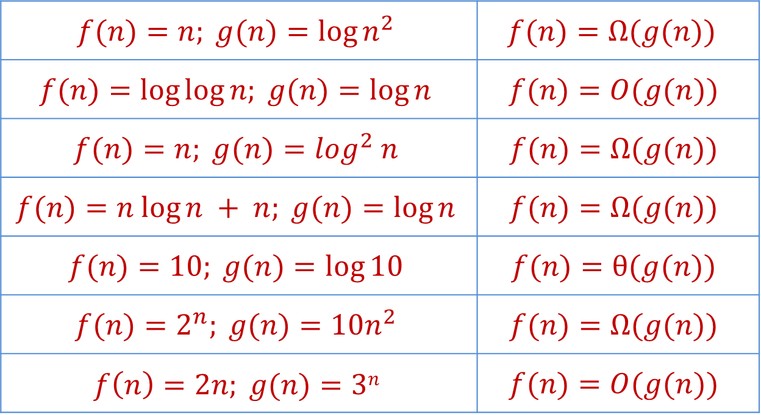
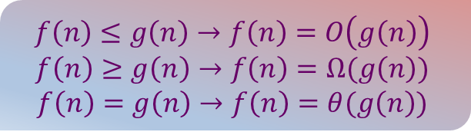
Exercises
$$f\left(n\right)≤g\left(n\right)→f\left(n\right)=O\left(g\left(n\right)\right)$$
$$f\left(n\right)≥g\left(n\right)→f\left(n\right)=Ω(g\left(n\right))$$
$$f\left(n\right)=g\left(n\right)→f\left(n\right)=θ(g\left(n\right))$$
For each of the following pairs of functions, either $f(n)$ is $O(g(n))$, $f(n)$ is $Ω(g(n))$, or $f(n) =θ(g(n))$. Determine which relationship is correct.
$$f(n)=n; g(n)=log⁡n^{2}$$ | $$f(n)=Ω(g(n))$$
$$f(n)=log⁡log⁡n; g(n)=log⁡n$$ | $$f(n)=O(g(n))$$
$$f(n)=n; g(n)=\log^{2} n$$ | $$f(n)=Ω(g(n))$$
$$f(n)=n log⁡n + n; g(n)=log⁡n$$ | $$f(n)=Ω(g(n))$$
$$f(n)=10; g(n)=log⁡10$$ | $$f(n)=θ(g(n))$$
$$f(n)=2^{n}; g(n)=10n^{2}$$ | $$f(n)=Ω(g(n))$$
$$f\left(n\right)=2n; g(n)=3n$$ | $$f(n)=O(g(n))$$

Slide 32
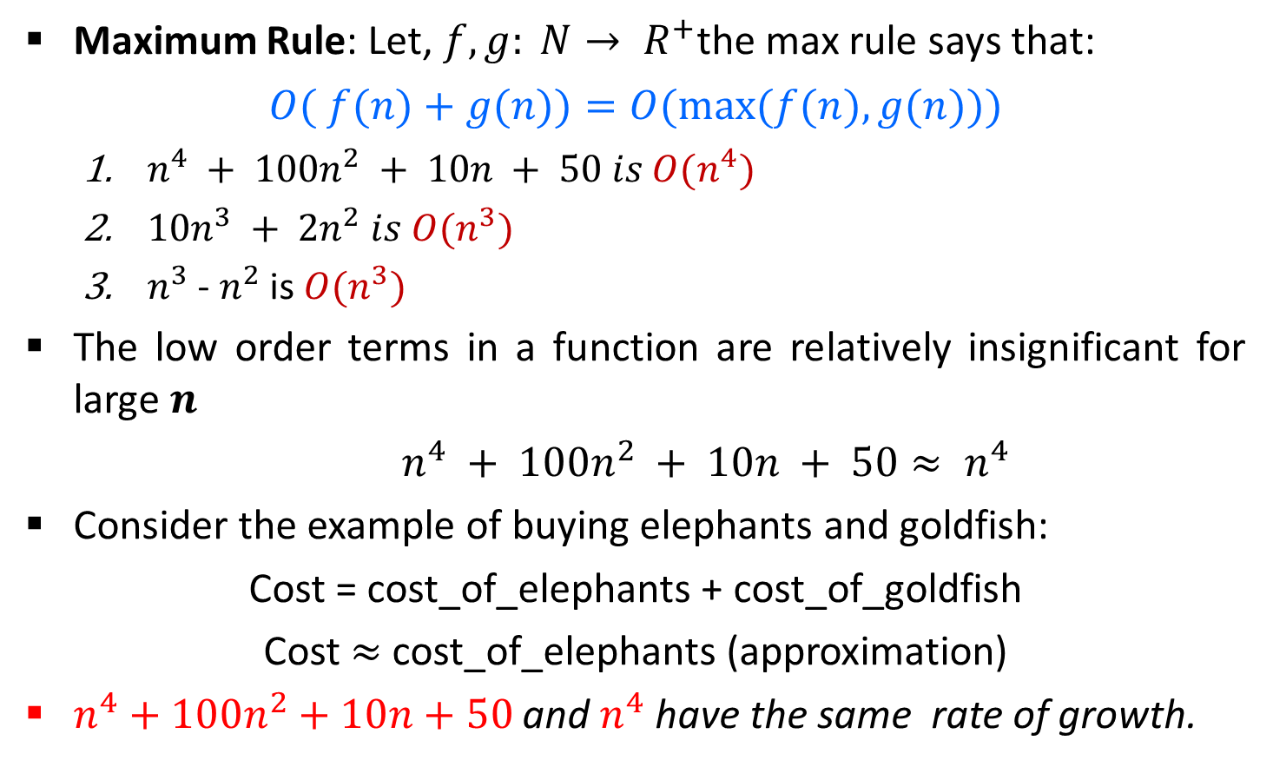
Asymptotic Notations in Equations
Maximum Rule: Let, $f, g: N→ R^{+}$the max rule says that:
$$O( f(n)+g(n))=O(max⁡(f(n),g(n)))$$
$n^{4} + 100n^{2} + 10n + 50 is O(n^{4})$
$10n^{3} + 2n^{2} is O(n^{3})$
$n^{3}$ - $n^{2}$ is $O(n^{3})$
The low order terms in a function are relatively insignificant for large $n$
$n^{4} + 100n^{2} + 10n + 50≈ n^{4}$
Consider the example of buying elephants and goldfish:
Cost = cost_of_elephants + cost_of_goldfish
Cost $≈$ cost_of_elephants (approximation)
$n^{4}+100n^{2}+10n+50$ and $n^{4}$ have the same rate of growth.
Negligible

Slide 33
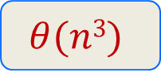
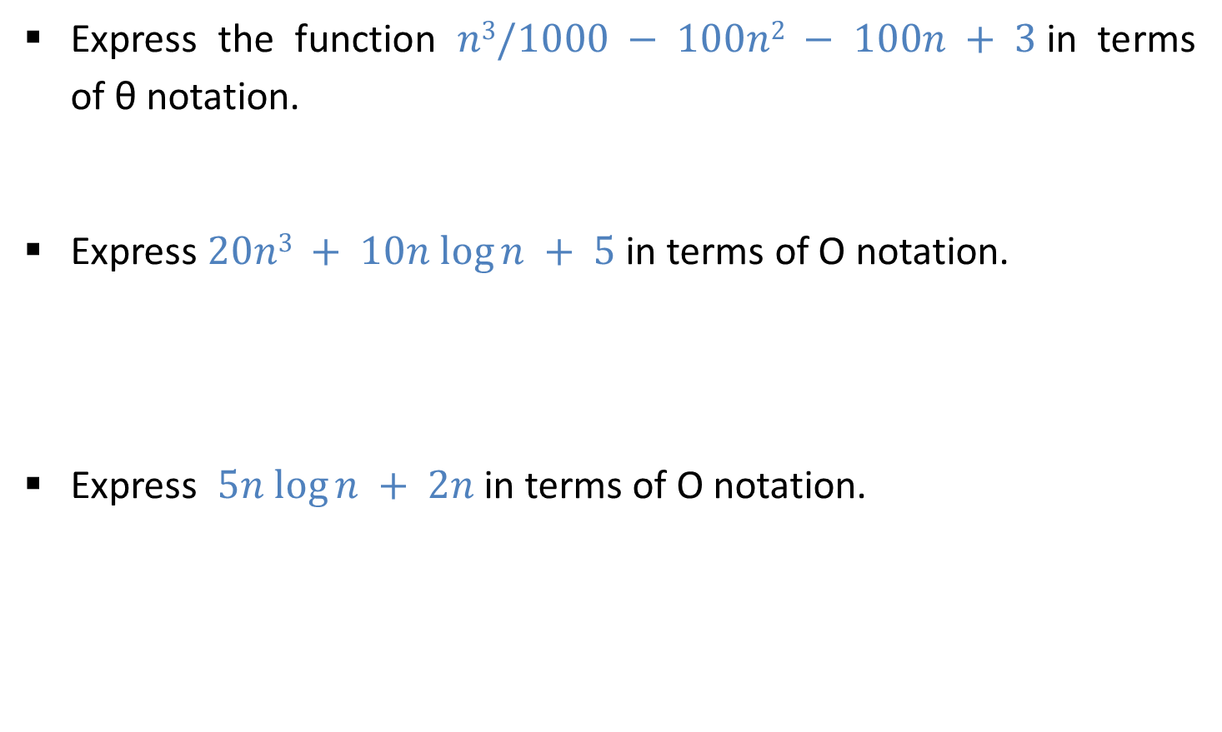
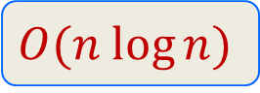
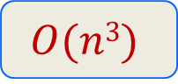
Exercises
Express the function $n3/1000 − 100n2 − 100n + 3$in terms of θ notation.
Express $20n3 + 10n log⁡n + 5$in terms of O notation.
Express $5n log⁡n + 2n$in terms of O notation.
$$θ(n3)$$
$$O(n3)$$
$$O(n log⁡n)$$

Slide 34
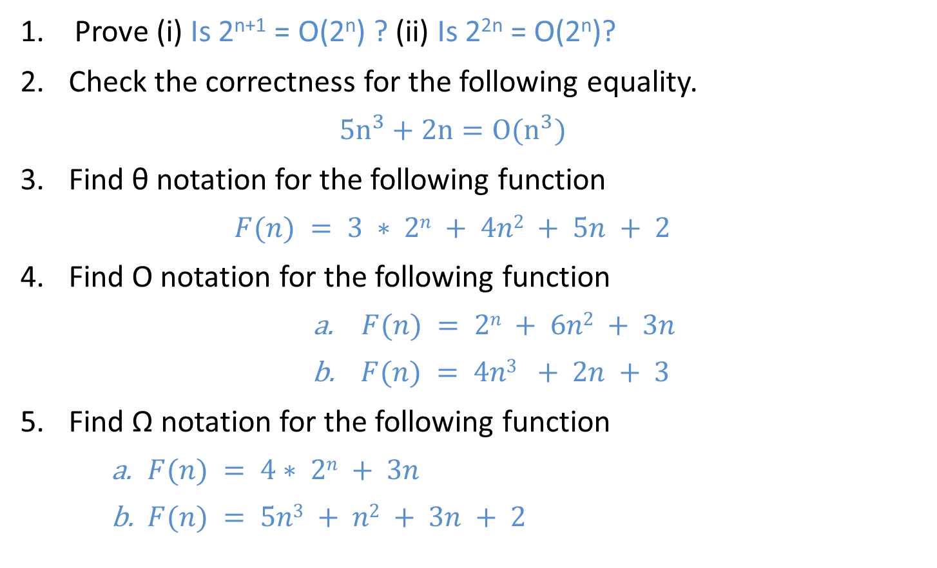
Home Work
Prove (i) Is 2^{n+1} = O(2^{n}) ? (ii) Is 2^{2n} = O(2^{n})?
Check the correctness for the following equality.
$$5n^{3}+2n=O(n^{3})$$
Find θ notation for the following function
$$F(n) = 3 ∗ 2n + 4n2 + 5n + 2$$
Find O notation for the following function
$F(n) = 2n + 6n2 + 3n$
$F(n) = 4n3 + 2n + 3$
Find Ω notation for the following function
$F(n) = 4∗ 2n + 3n$
$F(n) = 5n3 + n2 + 3n + 2$

Slide 35
Analyzing Control Statements

Slide 36
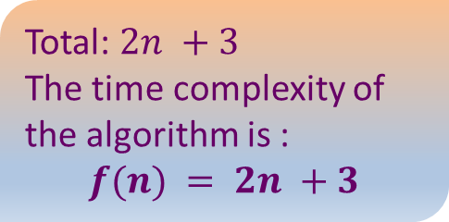
Sum of n Elements of Array
Algorithm
//Input: int A[n], array of n integers
//Output: Sum of all numbers in array A
int Sum(int A[], int n)
{
int s=0;
for (int i=0; i<n; i++)
s = s + A[i];
return s;
}
n+1
1
Total: $2n +3$
The time complexity of the algorithm is :
$$f(n) = 2n +3$$
n

Slide 37










Running Time of Algorithm
Estimated running time for different values of $n$:
As $n$ grows, the number of steps grow in linear proportion to $n$ for the given algorithm Sum.
The time complexity of the algorithm is :
$$f\left(n\right)= 2 ∙n +3$$
$$n=10$$
$23$ steps
$$n=100$$
$203$ steps
$$n=1000$$
$2,003$ steps
$$n=10000$$
$20,003$ steps

Slide 38


Running Time of Algorithm
The dominating term in the function of time complexity is $n$:
The time complexity of the algorithm is :
$$f\left(n\right)= 2 ∙n +3$$
$$n=10$$
$23$ steps
$$n=100$$
$203$ steps
$$n=1000$$
$2,003$ steps
$$n=10000$$
$20,003$ steps
As $n$ gets large, the $+3$ becomes insignificant.
The time is linear in proportion to $n$.

Slide 39















Analyzing Control Statement
Example 1:
$$sum=a+b$$
$$c$$
Example 3:
$$c_{1} \left(n+1\right)$$
$$for i=1 to n do$$
$$for j = 1 to n do$$
$$sum=a+b;$$
Statement is executed once only
$$c_{2} n \left(n+1\right)$$
The execution time $T(n)$ is some constant $c≈O(1)$
$$c_{3}∗n∗n$$
Analysis
$$T(n)=c_{1}(n+1)+c_{2}n(n+1)+c_{3}n(n)$$
Example 2:
$$T(n) =c_{1}n+c_{1}+c_{2}n2+c_{2}n+c_{3}n2$$
$$∗\left(n+1\right)$$
$$for i=1 to n do$$
$$sum=a+b;$$
$$c_{1}$$
$$T(n) = n2(c_{2}+c_{3}) + n(c_{1}+c_{2}) +c_{1}$$
$$∗\left(n\right)$$
$$T(n) = an2 + bn + c$$
$$c_{2}$$
Total time is denoted as,
$$T(n)=O\left(n^{2}\right)$$
$$T\left(n\right)=c_{1}n+c_{1}+c_{2}n$$
$$T(n)=n(c_{1}+c_{2})+c_{1}≈O(n)$$

Slide 40









Analyzing Control Statement
Example 4:
Example 6:
$$l = 0$$
$$for i = 1 to n do$$
$$for j = 1 to i do$$
$$for k = j to n do$$
$$l = l + 1$$
$$for j = 1 to n do$$
$$for k = 1 to j do$$
$$sum = sum + j∗k$$
$$for l =1 to n do$$
$$sum=sum− l + 1$$
printf(“sum is now %d”,$sum$)
$$θ\left(n^{2}\right)$$
$$θ\left(n\right)$$
$$t\left(n\right)=θ\left(n^{3}\right)$$
$$θ\left(1\right)$$
Example 5:
$$t\left(n\right)=θ\left(n^{2}\right)+θ\left(n\right)+θ\left(1\right)$$
$$t\left(n\right)=θ\left(n^{2}\right)$$
$$l = 0$$
$$for i = 1 to n do$$
$$for j = 1 to n^{2} do$$
$$for k =1 to n^{3} do$$
$$l = l + 1$$
$$t\left(n\right)=θ\left(n^{6}\right)$$

Slide 41



Home Work
Example 7:
Example 8:
$$l =1$$
$$while\left(l≤n\right)$$
$$Print l$$
$$l=l∗2$$
$$i=1$$
sum = 0
while ($i ≤ n$)
$$j = 1$$
While $(j ≤ n)$
sum = sum + $1$
$$j = j + 1$$
$$i = i + 1$$
Example 9:
$$for\left(i=0;i<n;i++\right)$$
$$for(j=n;j>0;j−−)$$
$$if\left(i<j\right)$$
$$c=c+1$$

Slide 42
Sorting Algorithms

Slide 43
Applications of Sorting
Phone Bill: the calls made are date wise sorted.
Bank statement or Credit card Bill: transactions made are date wise sorted.
Filling forms online: “select country” drop down box will have the name of countries sorted in Alphabetical order.
Online shopping: the items can be sorted price wise, date wise or relevance wise.
Files or folders on your desktop are sorted date wise.

Slide 44
Bubble Sort
Sort the following array in Ascending order
45 | 34 | 56 | 23 | 12
Pass 1 :
45
34
swap
34
34
34
34
45
45
45
45
56
56
56
23
swap
23
23
23
23
56
56
12
swap
12
12
12
12
56
if(A[j] > A[j+1])
swap(A[j],A[j+1])

Slide 45
Bubble Sort
Pass 2 :
Pass 3 :
Pass 4 :
34
34
34
34
23
23
23
swap
12
swap
34
45
45
12
23
23
23
34
12
swap
swap
23
12
23
23
34
45
45
12
swap
12
34
12
12
12
45
45
45
45
56
56
56
56
56
56
if(A[j] > A[j+1])
swap(A[j],A[j+1])

Slide 46
Bubble Sort
It is a simple sorting algorithm that works by
Comparing each pair of adjacent items and swapping them if they are in the wrong order.
The pass through the list is repeated until no swaps are needed, which indicates that the list is sorted.
As it only uses comparisons to operate on elements, it is a comparison sort.
Although the algorithm is simple, it is too slow for practical use.

Slide 47



Bubble Sort - Algorithm
# Input: Array A
# Output: Sorted array A
Algorithm: Bubble_Sort(A)
for i ← 1 to n do
for j ← 1 to n-i do
if A[j] > A[j+1] then
then temp ← A[j]
A[j] ← A[j+1]
A[j+1] ← temp
$$θ\left(n\right)$$
swap(A[j],A[j+1])
$$θ\left(n^{2}\right)$$
temp ← A[j]
A[j] ← A[j+1]
A[j+1] ← temp
The time complexity of bubble sort is
$$θ\left(n^{2}\right)$$

Slide 48



Bubble Sort - Analysis
Algorithm: Bubble_Sort(A) | Cost | Times
for i ← 1 to n do | $$c_{1}$$ | $$n$$
for j ← 1 to n-i do | $$c_{2}$$ | $\sum_{i=1}^{n−i}{(n−i+1)}$
if A[j] > A[j+1] | $$c_{3}$$ | $\sum_{i=1}^{n−i}{(n−i)}$
then temp ← A[j] A[j] ← A[j+1] A[j+1] ← temp | $$c_{4}$$ | $\sum_{i=1}^{n−i}{(n−i)}$
$T\left(n\right)= c_{1}(n)+c_{2}\sum_{i=1}^{n−i}{(n+1−i)}$ $+ c_{3}\sum_{i=1}^{n−i}{\left(n−i\right)+c_{4}\sum_{i=1}^{n−i}{(n−i)}}$
$$T\left(n\right)=θ\left(n^{2}\right)$$

Slide 49

Bubble Sort - Analysis
Analysis
$$T\left(n\right)={c_{1}\left(n\right)+c}_{2}\frac{n\left(n+1\right)}{2}+c_{3}\frac{n\left(n+1\right)}{2}+c_{4}n+c_{4}\frac{n(n+1)}{2}$$
$$T\left(n\right)=c_{1}n+c_{2}\frac{n^{2}}{2}+c_{2}\frac{n}{2}+c_{3}n−c_{3}\frac{n^{2}}{2}−c_{3}\frac{n}{2}+c_{4}n+c_{4}\frac{n^{2}}{2}+c_{4}\frac{n}{2}$$
$$T\left(n\right)= {an}^{2}+bn+c$$
$$T\left(n\right)=θ(n^{2})$$
$T\left(n\right)= c_{1}(n)+c_{2}\sum_{i=1}^{n−i}{(n+1−i)}$ $+ c_{3}\sum_{i=1}^{n−i}{\left(n−i\right)+c_{4}\sum_{i=1}^{n−i}{(n−i)}}$

Slide 50

Bubble Sort: Best Case Analysis
Best case time complexity = $θ\left(n\right)$
Pass 1 :
i = 1
int flag=1;
for(i = 1; i < n; i++)
for(j = 1; j < n-i; j++)
if(A[j] > A[j+1])
flag=0;
swap(A[j],A[j+1])
if(flag == 1)
cout<<"already sorted"<<endl
break;
12
j = 1
23
j = 2
34
j = 3
45
Condition never becomes true
j = 4
59
Only one iteration takes place from $1$ to $n−1$, i.e., Pass 1

Slide 51
Selection Sort
Sort the following elements in Ascending order
5 | 1 | 12 | -5 | 16 | 2 | 12 | 14
Step 1 :
Unsorted Array
5 | 1 | 12 | -5 | 16 | 2 | 12 | 14
1 | 2 | 3 | 4 | 5 | 6 | 7 | 8
Step 2 :
Unsorted Array (elements 2 to 8)
Minj = 1, Minx = 5
5
Find the smallest value from the entire Unsorted array
-5
1
12
-5
5
16
2
12
14
1
2
3
4
5
6
7
8
Index = 4, value = -5
Swap

Slide 52
Selection Sort
Step 3 :
Minj = 2, Minx = 1
Unsorted Array (elements 3 to 8)
-5
1
Find min value from
Remaining unsorted array
Index = 2, value = 1
1
12
5
16
2
12
14
1
2
3
4
5
6
7
8
No Swapping as min value is already at right place
Step 4 :
Unsorted Array
(elements 4 to 8)
Minj = 3, Minx = 12
-5
1
12
Find min value from
Remaining unsorted array
Index = 6, value = 2
2
5
16
2
12
12
14
1
2
3
4
5
6
7
8
Swap

Slide 53
Selection Sort
Step 5 :
Unsorted Array
(elements 5 to 8)
Minj = 4, Minx = 5
Find min value from
Remaining unsorted array
Index = 4, value = 5
-5
1
2
5
5
16
12
12
14
1
2
3
4
5
6
7
8
No Swapping as min value is already at right place
Step 6 :
Unsorted Array
(elements 6 to 8)
Minj = 5, Minx = 16
-5
1
2
5
16
12
12
16
12
14
Find min value from
Remaining unsorted array
Index = 6, value = 12
1
2
3
4
5
6
7
8
Swap

Slide 54
Selection Sort
Step 7 :
Unsorted Array
(elements 7 to 8)
Minj = 6, Minx = 16
Find min value from
Remaining unsorted array
Index = 7, value = 12
-5
1
2
5
12
16
12
12
16
14
1
2
3
4
5
6
7
8
Swap
Step 8 :
Unsorted Array
(element 8)
Minj = 7, Minx = 16
-5
1
2
5
12
12
16
14
14
16
Find min value from
Remaining unsorted array
Index = 8, value = 14
1
2
3
4
5
6
7
8
Swap

Slide 55
Selection Sort
Selection sort divides the array or list into two parts,
The sorted part at the left end
and the unsorted part at the right end.
Initially, the sorted part is empty and the unsorted part is the entire list.
The smallest element is selected from the unsorted array and swapped with the leftmost element, and that element becomes a part of the sorted array.
Then it finds the second smallest element and exchanges it with the element in the second leftmost position.
This process continues until the entire array is sorted.

Slide 56
Selection Sort - Algorithm
# Input: Array A
# Output: Sorted array A
Algorithm: Selection_Sort(A)
for i ← 1 to n-1 do
minj ← i;
minx ← A[i];
for j ← i + 1 to n do
if A[j] < minx then
minj ← j;
minx ← A[j];
A[minj] ← A[i];
A[i] ← minx;

Slide 57
Selection Sort - Example
Algorithm: Selection_Sort(A)
for i ← 1 to n-1 do
minj ← i; minx ← A[i];
for j ← i + 1 to n do
if A[j] < minx then
minj ← j ; minx ← A[j];
A[minj] ← A[i];
A[i] ← minx;
Pass 1 :
i = 1
2
minj ← 1
minx ← 45
34
34
3
j = 2
No Change
Sort in Ascending order
45 | 34 | 56 | 23 | 12
45
1 | 2 | 3 | 4 | 5

Slide 58
Selection Sort Example
Algorithm: Selection_Sort(A)
for i ← 1 to n-1 do
minj ← i ; minx ← A[i];
for j ← i + 1 to n do
if A[j] < minx then
minj ← j ; minx ← A[j];
A[minj] ← A[i];
A[i] ← minx;
Pass 1 :
i = 1
minj ← 1
5
2
4
34
12
23
minx ← 45
3
5
j = 2
4
Sort in Ascending order
Unsorted Array
45 | 34 | 56 | 23 | 12
45
45 | 34 | 56 | 23 | 12
12
45
1 | 2 | 3 | 4 | 5
1 | 2 | 3 | 4 | 5
34
56
34
45
45 | 34 | 56 | 23 | 45
12
23
56

Slide 59
Selection Sort - Algorithm
# Input: Array A
# Output: Sorted array A
Algorithm: Selection_Sort(A)
for i ← 1 to n-1 do
minj ← i;
minx ← A[i];
for j ← i + 1 to n do
if A[j] < minx then
minj ← j;
minx ← A[j];
A[minj] ← A[i];
A[i] ← minx;

Slide 60



Selection Sort - Analysis
# Input: Array A
# Output: Sorted array A
Algorithm: Selection_Sort(A)
for i ← 1 to n-1 do
minj ← i;
minx ← A[i];
for j ← i + 1 to n do
if A[j] < minx then
minj ← j;
minx ← A[j];
A[minj] ← A[i];
A[i] ← minx;
$$θ\left(n\right)$$
$$θ\left(n^{2}\right)$$
The time complexity of Selection sort is
$$θ\left(n^{2}\right)$$

Slide 61

Selection Sort - Analysis
Algorithm: Selection_Sort(A) | Cost | Times
for i ← 1 to n-1 do | $$c_{1}$$ | $$n$$
minj ← i ; minx ← A[i]; | $$c_{2}$$ | $$n−1$$
for j ← i + 1 to n do | $$c_{3}$$ | $$\sum_{i+1}^{n}{(i+1)}$$
if A[j] < minx then | $$c_{4}$$ | $$\sum_{i+1}^{n}{i}$$
minj ← j ; minx = A[j] | $$c_{5}$$ | $$\sum_{i+1}^{n}{i}$$
A[minj] = A[i]; | $$c_{6}$$ | $$n−1$$
A[i] = minx; | $$c_{7}$$ | $$n−1$$

Slide 62

Selection Sort - Analysis
$$T\left(n\right)=c_{1}n+c_{2}\left(n−1\right)+c_{3}\left(\sum_{i=1}^{n−1}{\left(i+1\right)}\right)+c_{4}\left(\sum_{i=1}^{n−1}{i}\right)+c_{5}\sum_{i=1}^{n−1}{i}+c_{6}\left(n−1\right)+c_{7}\left(n−1\right)$$
$$T\left(n\right)=c_{1}n+c_{2}\left(n−1\right)+c_{3}\left(\frac{n(n+1)}{2}\right)+c_{4}\left(\frac{n(n+1)}{2}\right)+c_{5}\left(\frac{n(n+1)}{2}\right)+c_{6}\left(n−1\right)+c_{7}\left(n−1\right)$$
$$T\left(n\right)=an^{2}+bn+c=θ\left(n^{2}\right)$$
The time complexity of Selection sort algorithm is $T\left(n\right)=θ\left(n^{2}\right)$

Slide 63




Insertion Sort - Example
Sort the following elements in Ascending order
5 | 1 | 12 | -5 | 16 | 2 | 12 | 14
Step 1 :
Unsorted Array
5 | 1 | 12 | -5 | 16 | 2 | 12 | 14
1 | 2 | 3 | 4 | 5 | 6 | 7 | 8
Step 2 :
$$j$$
$$i=2, x=1$$
$$j=i –1 and j>0$$
1
5
1
12
-5
16
2
12
14
while $x<T\left[j\right]$ do
$$T\left[j+1\right]←T\left[j\right]$$
$$j−−$$
1
2
3
4
5
6
7
8
Shift down

Slide 64









Insertion Sort - Example
Step 3 :
$$i=3, x=12$$
$$j=i –1 and j>0$$
$$j$$
while $x<T\left[j\right]$ do
$$T\left[j+1\right]←T\left[j\right]$$
$$j−−$$
1
5
12
-5
16
2
12
14
1
2
3
4
5
6
7
8
No Shift will take place
Step 4 :
$$j$$
$$j$$
$$i=4, x=−5$$
$$j=i –1 and j>0$$
while $x<T\left[j\right]$ do
$$T\left[j+1\right]←T\left[j\right]$$
$$j−−$$
1
5
12
-5
16
2
12
14
-5
1
2
3
4
5
6
7
8
Shift down
Shift down
Shift down

Slide 65








Insertion Sort - Example
Step 5 :
$$i=5, x=16$$
$$j=i –1 and j>0$$
$$j$$
while $x<T\left[j\right]$ do
$$T\left[j+1\right]←T\left[j\right]$$
$$j−−$$
-5
1
5
12
16
2
12
14
1
2
3
4
5
6
7
8
No Shift will take place
Step 6 :
$$i=6, x=2$$
$$j=i –1 and j>0$$
$$j$$
$$j$$
while $x<T\left[j\right]$ do
$$T\left[j+1\right]←T\left[j\right]$$
$$j−−$$
-5
1
2
5
12
16
2
12
14
1
2
3
4
5
6
7
8
Shift down
Shift down
Shift down

Slide 66






Insertion Sort - Example
Step 7 :
$$i=7, x=12$$
$$j=i –1 and j>0$$
$$j$$
while $x<T\left[j\right]$ do
$$T\left[j+1\right]←T\left[j\right]$$
$$j−−$$
-5
1
2
5
12
12
16
12
14
1
2
3
4
5
6
7
8
Shift down
Step 8 :
$$j$$
$$i=8, x=14$$
$$j=i –1 and j>0$$
-5
1
2
5
12
12
14
while $x<T\left[j\right]$ do
$$T\left[j+1\right]←T\left[j\right]$$
$$j−−$$
16
14
1
2
3
4
5
6
7
8
Shift down

Slide 67
Insertion Sort - Algorithm
# Input: Array T
# Output: Sorted array T
Algorithm: Insertion_Sort(T[1,…,n])
for i ← 2 to n do
x ← T[i];
j ← i – 1;
while x < T[j] and j > 0 do
T[j+1] ← T[j];
j ← j – 1;
T[j+1] ← x;

Slide 68


Insertion Sort - Analysis
# Input: Array T
# Output: Sorted array T
Algorithm: Insertion_Sort(T[1,…,n])
for i ← 2 to n do
x ← T[i];
j ← i – 1;
while x < T[j] and j > 0 do
T[j+1] ← T[j];
j ← j – 1;
T[j+1] ← x;
$$θ\left(n\right)$$
$$θ\left(n^{2}\right)$$
The time complexity of Insertion sort is
$$θ\left(n^{2}\right)$$

Slide 69

Insertion Sort – Best Case Analysis
Pass 1 :
# Input: Array T
# Output: Sorted array T
Algorithm: Insertion_Sort(T[1,…,n])
for i ← 2 to n do
x ← T[i];
j ← i - 1;
while x < T[j] and j > 0 do
T[j+1] ← T[j];
j ← j – 1;
T[j+1] ← x;
12
23
i=2
T[j]=12
34
i=3
T[j]=23
45
i=4
T[j]=34
59
i=5
T[j]=45
The best case time complexity of Insertion sort is
$$θ\left(n\right)$$

Slide 70

Insertion Sort - Analysis
Algorithm: Insertion_Sort(T) | Cost | Times
for i←2 to n do | $$c_{1}$$ | $$n$$
x←T[i] | $$c_{2}$$ | $$n−1$$
j←i-1 | $$c_{3}$$ | $$n−1$$
while x<T[j] and j>0 do | $$c_{4}$$ | $$\sum_{i=2}^{n}{T_{j}}$$
T[j+1] ← T[j] | $$c_{5}$$ | $$\sum_{i=2}^{n}{T_{j−1}}$$
j = j - 1 | $$c_{6}$$ | $$\sum_{i=2}^{n}{T_{j−1}}$$
T[j+1] = x; | $$c_{7}$$ | $$n−1$$

Slide 71

Insertion Sort – Time Complexity
$$T\left(n\right)=c1n+c2(n−1)+c3(n−1)+c4 \sum_{i=2}^{n}{T_{j}}+\sum_{i=2}^{n}{T_{j−1}}\left(c5 +c6\right)+ c7(n−1)$$
$$\sum_{i=2}^{n}{Tj}=\sum_{i=2}^{n}{n−i}$$
$$T\left(n\right)=c1n+c2(n−1)+c3(n−1)+c4\sum_{i=2}^{n}{n−i}+\left(c5 +c6\right)\sum_{i=2}^{n}{n−i}+ c7(n−1)$$
$c1n+c2n+ c3n$+ c₄$\frac{n}{2}$ +c₅$\frac{n}{2}$+ c₆$\frac{n}{2}−$ c₄$\frac{n^{2}}{2}−$ c₅$\frac{n^{2}}{2}−$ c₆$\frac{n^{2}}{2}$+ $c7n−c2−c3− c7$
=$n2$(-C₄$\frac{1}{2}$- C₅$\frac{1}{2}$- C₆$\frac{1}{2})+ n$(C₁ +C₂ +C₃ +C₇ + C₄$\frac{1}{2}$+ C₅$\frac{1}{2}$+ C₆$\frac{1}{2}$)- 1(C₂ +C₃ +C₇)
= $an2 + bn + c$
The time complexity of Insertion sort algorithm is $T\left(n\right)=θ\left(n^{2}\right)$

Slide 72
Insertion Sort - Example
Sort given elements in descending order using insertion sort: 3, 9, 6, 5, 23, 14
Step 1 :
Step 5:
 |  |  | 5 | 23 | 14
3 | 9 | 6 | 5 | 23 | 14
23
6
5
3
9
Step 2 :
Step 6 :
3 | 9 | 6 | 5 | 23 | 14
9
3
9
 |  |  |  |  | 14
23
14
6
5
3
Step 3 :
6
3
3 | 3 | 6 | 5 | 23 | 14
9
Step 4 :
6
5
3
3 | 3 | 3 | 5 | 23 | 14
9

Slide 73
Tutorial Questions
Explain selection sort algorithm with its time complexity. Sort the given elements using your algorithm.
Discuss insertion sort algorithm with its time complexity. Support your answer by sorting given elements.

Slide 74
Introduction to Heap
A heap data structure is a binary tree with the following two properties.
It is a complete binary tree: Each level of the tree is completely filled, except possibly the bottom level. At this level it is filled from left to right.
a
a
b
c
b
c
d
e
f
d
e
f
Binary Tree
Complete Binary Tree - Heap

Slide 75
Introduction to Heap
It satisfies the heap order property: the data item stored in each node is greater than or equal to the data item stored in its children node.
9
9
6
7
6
7
2
4
8
2
4
1
Not a Heap
Heap

Slide 76

Array Representation of Heap
Heap can be implemented using an Array.
An array $A$ that represents a heap is an object with two attributes:
$length[A],$which is the number of elements in the array, and
$heap−size[A]$, the number of elements in the heap stored within array $A$.
Heap
16
14
10
8
7
9
3
Array representation of heap
2
4
1
16
14
10
8
7
9
3
2
4
1

Slide 77













Array Representation of Heap
In the array $A$, that represents a heap
length$[A]$= heap-size$[A]$
For any node $i$ the parent node is $i/2$
For any node $j$, its left child is $2j$and right child is $2j+1$
$$1$$
16
For node $i=4$, parent node is $4/2=2$
$$2$$
$$3$$
14
10
For node $i=4$,
Left child node is $2∗4=$node $8$
Right child is $2∗4+1=$node $9$
$$4$$
$$5$$
$$6$$
$$7$$
8
7
9
3
$$8$$
$$9$$
$$10$$
$$1$$ | $$2$$ | $$3$$ | $$4$$ | $$5$$ | $$6$$ | $$7$$ | $$8$$ | $$9$$ | $$10$$
2
4
1
16
14
10
8
7
9
3
2
4
1

Slide 78
Types of Heap
Max-Heap − Where the value of the root node is greater than or equal to either of its children.
9
6
7
2
4
1
1
Min-Heap − Where the value of the root node is less than or equal to either of its children.
2
4
6
7
9

Slide 79
Heap Sort
Build the complete binary tree using given elements.
Create Max-heap to sort in ascending order.
Once the heap is created, swap the last node with the root node and delete the last node from the heap.
Repeat step 2 and 3 until the heap is empty.

Slide 80

Heap Sort – Example 1
Sort the following elements in Ascending order
4 | 10 | 3 | 5 | 1
$$1$$ | $$2$$ | $$3$$ | $$4$$ | $$5$$
4 | 10 | 3 | 5 | 1
Step 1 : Build Heap
4
10

Slide 81
Heap Sort – Example 1
Sort the following elements in Ascending order
4 | 10 | 3 | 5 | 1
$$1$$ | $$2$$ | $$3$$ | $$4$$ | $$5$$
4 | 10 | 3 | 5 | 1
Step 1 : Build Heap
4
10
3

Slide 82
Heap Sort – Example 1
Sort the following elements in Ascending order
4 | 10 | 3 | 5 | 1
$$1$$ | $$2$$ | $$3$$ | $$4$$ | $$5$$
4 | 10 | 3 | 5 | 1
Step 1 : Build Heap
4
10
3
5

Slide 83
Heap Sort – Example 1
Sort the following elements in Ascending order
4 | 10 | 3 | 5 | 1
$$1$$ | $$2$$ | $$3$$ | $$4$$ | $$5$$
4 | 10 | 3 | 5 | 1
Step 1 : Build Heap
4
Now, a binary tree is created and we have to convert it into a Heap.
10
3
5
1

Slide 84
Heap Sort – Example 1
Sort the following elements in Ascending order
4 | 10 | 3 | 5 | 1
$$1$$ | $$2$$ | $$3$$ | $$4$$ | $$5$$
4 | 10 | 3 | 5 | 1
Step 1 : Build Heap
Create Max Heap
4
In a Max Heap, parent node is always greater than or equal to the child nodes.
10
3
5
1

Slide 85
Heap Sort – Example 1
Sort the following elements in Ascending order
4 | 10 | 3 | 5 | 1
$$1$$ | $$2$$ | $$3$$ | $$4$$ | $$5$$
 |  | 3 | 5 | 1
4
10
Step 1 : Build Heap
Create Max Heap
4
In a Max Heap, parent node is always greater than or equal to the child nodes.
10 is greater than 4
10
3
So, swap 10 & 4
5
1

Slide 86
Heap Sort – Example 1
Sort the following elements in Ascending order
4 | 10 | 3 | 5 | 1
$$1$$ | $$2$$ | $$3$$ | $$4$$ | $$5$$
 |  | 3 | 5 | 1
4
10
Step 1 : Build Heap
Swap
Create Max Heap
10
In a Max Heap, parent node is always greater than or equal to the child nodes.
10 is greater than 4
4
3
So, swap 10 & 4
5
1

Slide 87
Heap Sort – Example 1
Sort the following elements in Ascending order
4 | 10 | 3 | 5 | 1
$$1$$ | $$2$$ | $$3$$ | $$4$$ | $$5$$
 |  | 3 |  | 1
10
4
5
Step 1 : Build Heap
Swap
Create Max Heap
10
In a Max Heap, parent node is always greater than or equal to the child nodes.
5 is greater than 4
4
3
So, swap 5 & 4
5
1

Slide 88
Heap Sort – Example 1
Sort the following elements in Ascending order
4 | 10 | 3 | 5 | 1
$$1$$ | $$2$$ | $$3$$ | $$4$$ | $$5$$
 |  | 3 |  | 1
10
5
4
Step 2 : Heap Sort
Max Heap is build
10
Swap the first and the last nodes and delete the last node.
5
3
4
1

Slide 89
Heap Sort – Example 1
Sort the following elements in Ascending order
4 | 10 | 3 | 5 | 1
$$1$$ | $$2$$ | $$3$$ | $$4$$ | $$5$$
1
 |  | 3
10
5
4
Step 2 : Heap Sort
Swap
Max Heap is build
10
Swap the first and the last nodes and delete the last node.
5
3
4
1

Slide 90
Heap Sort – Example 1
Sort the following elements in Ascending order
4 | 10 | 3 | 5 | 1
$$1$$ | $$2$$ | $$3$$ | $$4$$ | $$5$$
10
 |  | 3
1
5
4
Step 2 : Heap Sort
Max Heap is build
1
Swap the first and the last nodes and delete the last node.
5
3
4
10

Slide 91
Heap Sort – Example 1
Sort the following elements in Ascending order
4 | 10 | 3 | 5 | 1
$$1$$ | $$2$$ | $$3$$ | $$4$$ | $$5$$
10
 |  | 3
1
5
4
Step 2 : Heap Sort
Create Max Heap
1
In a Max Heap, parent node is always greater than or equal to the child nodes.
5
3
4

Slide 92
Heap Sort – Example 1
Sort the following elements in Ascending order
4 | 10 | 3 | 5 | 1
$$1$$ | $$2$$ | $$3$$ | $$4$$ | $$5$$
10
 |  | 3
5
1
4
Step 2 : Heap Sort
Create Max Heap
5
In a Max Heap, parent node is always greater than or equal to the child nodes.
1
3
4

Slide 93
Heap Sort – Example 1
Sort the following elements in Ascending order
4 | 10 | 3 | 5 | 1
$$1$$ | $$2$$ | $$3$$ | $$4$$ | $$5$$
4
1
10
 |  | 3
5
Step 2 : Heap Sort
Max Heap is build
5
Swap the first and the last nodes and delete the last node.
4
3
1

Slide 94
Heap Sort – Example 1
Sort the following elements in Ascending order
4 | 10 | 3 | 5 | 1
$$1$$ | $$2$$ | $$3$$ | $$4$$ | $$5$$
1
4
10
 |  | 3
5
Step 2 : Heap Sort
Max Heap is build
1
Swap the first and the last nodes and delete the last node.
4
3
5

Slide 95
Heap Sort – Example 1
Sort the following elements in Ascending order
4 | 10 | 3 | 5 | 1
$$1$$ | $$2$$ | $$3$$ | $$4$$ | $$5$$
1
4
10
 |  | 3
5
Step 2 : Heap Sort
Create Max Heap
1
In a Max Heap, parent node is always greater than or equal to the child nodes.
4
3

Slide 96
Heap Sort – Example 1
Sort the following elements in Ascending order
4 | 10 | 3 | 5 | 1
$$1$$ | $$2$$ | $$3$$ | $$4$$ | $$5$$
4
1
3
5
10
Step 2 : Heap Sort
Max Heap is build
4
Swap the first and the last nodes and delete the last node.
1
3

Slide 97
Heap Sort – Example 1
Sort the following elements in Ascending order
4 | 10 | 3 | 5 | 1
$$1$$ | $$2$$ | $$3$$ | $$4$$ | $$5$$
3
1
4
5
10
Step 2 : Heap Sort
Max Heap is build
3
Swap the first and the last nodes and delete the last node.
1
4

Slide 98
Heap Sort – Example 1
Sort the following elements in Ascending order
4 | 10 | 3 | 5 | 1
$$1$$ | $$2$$ | $$3$$ | $$4$$ | $$5$$
3
1
4
5
10
Step 2 : Heap Sort
Max Heap is build
3
Swap the first and the last nodes and delete the last node.
1

Slide 99
Heap Sort – Example 1
Sort the following elements in Ascending order
4 | 10 | 3 | 5 | 1
$$1$$ | $$2$$ | $$3$$ | $$4$$ | $$5$$
1
3
4
5
10
Step 2 : Heap Sort
Max Heap is build
1
Swap the first and the last nodes and delete the last node.
3
Remove the last element from heap and the sorting is over.

Slide 100
Heap Sort – Example 2
Sort given element in ascending order using heap sort. 19, 7, 16, 1, 14, 17
Step 1: Create binary tree
19 | 7 | 16 | 1 | 14 | 17
Step 2: Create Max-heap
19
19
7
16
14
17
1
14
17
1
7
16

Slide 101
Heap Sort – Example 2
19 | 14 | 17 | 1 | 7 | 16
16 | 14 | 17 | 1 | 7 | 19
19
16
Swap & remove the last element
14
17
14
17
1
7
16
1
7
Create Max-heap

Slide 102
Heap Sort – Example 2
17 | 14 | 16 | 1 | 7 | 19
7 | 14 | 16 | 1 | 17 | 19
17
7
Swap & remove the last element
14
16
14
16
1
7
1
Create Max-heap

Slide 103
Heap Sort – Example 2
16 | 14 | 7 | 1 | 17 | 19
1 | 14 | 7 | 16 | 17 | 19
16
1
Swap & remove the last element
14
7
14
7
1
Create Max-heap

Slide 104
Heap Sort – Example 2
14 | 1 | 7 | 16 | 17 | 19
7 | 1 | 14 | 16 | 17 | 19
14
Swap & remove the last element
7
1
7
1
Already a Max-heap
Swap & remove the last element

Slide 105
Heap Sort – Example 2
1 | 7 | 14 | 16 | 17 | 19
1 | 7 | 14 | 16 | 17 | 19
The final array is sorted
1
Remove the last element

Slide 106

Heap Sort - Algorithm
# Input: Array A
# Output: Sorted array A
Algorithm: Heap_Sort(A[1,…,n])
BUILD-MAX-HEAP(A)
for i $←$ length[A] downto 2
do exchange A[1] $↔$ A[i]
heap-size[A] $←$ heap-size[A] - 1
MAX-HEAPIFY(A, 1, n)

Slide 107
Build-Max-Heap - Algorithm
Algorithm: BUILD-MAX-HEAP(A)
heap-size[A] ← length[A]
for i ← ⌊length[A]/2⌋ downto 1
do MAX-HEAPIFY(A, i)
4 | 1 | 3 | 2 | 9 | 7
1
4
2
3
1
3
4
5
6
heap-size[A] = 6
2
9
7
4 | 1 | 7 | 2 | 9 | 3
4 | 9 | 7 | 2 | 1 | 3
9 | 4 | 7 | 2 | 1 | 3
i = 3
1
4
i = 2
1
i = 1
1
4
4
9
2
3
2
3
2
3
3
1
7
9
7
4
7
1
9
4
5
6
4
5
6
4
5
6
2
9
3
1
1
7
2
9
3
2
3

Slide 108

Heap Sort - Algorithm
# Input: Array A
# Output: Sorted array A
Algorithm: Heap_Sort(A[1,…,n])
BUILD-MAX-HEAP(A)
for i $←$ length[A] downto 2
do exchange A[1] $↔$ A[i]
heap-size[A] $←$ heap-size[A] - 1
MAX-HEAPIFY(A, 1, n)
9 | 4 | 7 | 2 | 1 | 3
1
9
2
3
4
7
4
5
6
2
1
3

Slide 109
Heap Sort - Algorithm
# Input: Array A
# Output: Sorted array A
Algorithm: Heap_Sort(A[1,…,n])
BUILD-MAX-HEAP(A)
for i $←$ length[A] downto 2
do exchange A[1] $↔$ A[i]
heap-size[A] $←$ heap-size[A] - 1
MAX-HEAPIFY(A, 1, n)
3 | 4 | 7 | 2 | 1 | 9
1
3
2
3
4
7
4
5
6
2
1
9

Slide 110





Max-Heapify - Algorithm
Algorithm: Max-heapify(A, i, n)
l $←$ LEFT(i)
r $←$ RIGHT(i)
if l ≤ n and A[l] > A[i]
then largest $←$l
else largest $←$i
if r ≤ n and A[r] > A[largest]
then largest $←$r
if largest $≠$ i
then exchange A[i] $↔$ A[largest]
MAX-HEAPIFY(A, largest, n)
1
3
l $←$ 2
1
2
3
r $←$ 3
4
7
Yes
4
5
largest $←$ 2
2
1
Yes
largest $←$ 3
Yes

Slide 111



Heap Sort - Algorithm
# Input: Array A
# Output: Sorted array A
Algorithm: Heap_Sort(A[1,…,n])
BUILD-MAX-HEAP(A)
for i $←$ length[A] downto 2
do exchange A[1] $↔$ A[i]
heap-size[A] $←$ heap-size[A] - 1
MAX-HEAPIFY(A, 1, n)
1
7
2
3
4
3
4
5
2
1
$$O(n−1)$$
$$O\left(\log{n}\right)$$

Slide 112





Heap Sort - Analysis
# Input: Array A
# Output: Sorted array A
Algorithm: Heap_Sort(A[1,…,n])
BUILD-MAX-HEAP(A)
for i $←$ length[A] downto 2
do exchange A[1] $↔$ A[i]
heap-size[A] $←$ heap-size[A] - 1
MAX-HEAPIFY(A, 1, n)
$$O(n log⁡n)$$
$$n−1$$
$$O( log⁡n)$$
Running time of heap sort algorithm is:
$$O\left(n log n\right)+O(\log{n)\left(n−1\right)=O(n\log{n)}}$$

Slide 113
Exercises (HW)
Sort given element in ascending order using heap sort.
Sort given element in descending order using heap sort.
65, 77, 5, 25, 32, 45, 99, 83, 69, 81
Sort the given elements with Heap Sort Method: 20, 50, 30, 75, 90, 60, 25, 10, 40.
4 | 1 | 3 | 2 | 16 | 9 | 10 | 14 | 8 | 7

Slide 114
Shell Sort - Example
Sort the following elements in ascending order using shell sort.
80
93
60
12
42
30
68
85
10
Step 1: Divide input array into segments, where Initial Segmenting Gap = 4 (n÷2)
$$1$$ | $$2$$ | $$3$$ | $$4$$ | $$5$$ | $$6$$ | $$7$$ | $$8$$ | $$9$$
80
93
60
12
42
30
68
85
10
$$1$$ | $$2$$ | $$3$$ | $$4$$ | $$5$$ | $$6$$ | $$7$$ | $$8$$ | $$9$$
10
93
60
12
42
30
68
85
80

Slide 115
Shell Sort - Example
Step 1: Initial Segmenting Gap = 4 (n÷2)
$$1$$ | $$2$$ | $$3$$ | $$4$$ | $$5$$ | $$6$$ | $$7$$ | $$8$$ | $$9$$
10
30
60
12
42
93
68
85
80
$$1$$ | $$2$$ | $$3$$ | $$4$$ | $$5$$ | $$6$$ | $$7$$ | $$8$$ | $$9$$
10
30
60
12
42
93
68
85
80
$$1$$ | $$2$$ | $$3$$ | $$4$$ | $$5$$ | $$6$$ | $$7$$ | $$8$$ | $$9$$
10
30
60
12
42
93
68
85
80

Slide 116
Shell Sort - Example
Step 2: Now, the Segmenting Gap = 2 (4 ÷2)
$$1$$ | $$2$$ | $$3$$ | $$4$$ | $$5$$ | $$6$$ | $$7$$ | $$8$$ | $$9$$
10
30
60
12
42
93
68
85
80
$$1$$ | $$2$$ | $$3$$ | $$4$$ | $$5$$ | $$6$$ | $$7$$ | $$8$$ | $$9$$
10
30
42
12
60
93
68
85
80
$$1$$ | $$2$$ | $$3$$ | $$4$$ | $$5$$ | $$6$$ | $$7$$ | $$8$$ | $$9$$
10
12
42
30
60
85
68
93
80

Slide 117
Shell Sort - Example
Step 3: Segmenting Gap = 1 (2 ÷2)
$$1$$ | $$2$$ | $$3$$ | $$4$$ | $$5$$ | $$6$$ | $$7$$ | $$8$$ | $$9$$
10
12
42
30
60
85
68
93
80
$$1$$ | $$2$$ | $$3$$ | $$4$$ | $$5$$ | $$6$$ | $$7$$ | $$8$$ | $$9$$
10
12
30
42
60
68
80
85
93
The final array is sorted

Slide 118

Shell Sort - Procedure
Divide the array into several smaller non contiguous segments.
The distance between successive elements in one segment is called a gap.
Each segment is sorted within itself using insertion sort.
Then re-segment into larger segments (smaller gap) and repeat sorting process.
Continue until only one segment is left, i.e., gap = 1.
Final sorting finishes the entire array sorting.
Time complexity of shell sort is $O(n2)$

Slide 119
Shell Sort - Exercise
Sort the following array in descending order using Shell Sort.
45
96
29
30
27
12
39
61
91

Slide 120

Radix Sort
Radix Sort puts the elements in order by comparing the digits of the numbers.
Each element in the $n$-element array $A$ has $d$ digits, where digit $1$ is the lowest-order digit and digit $d$ is the highest order digit.
Sort following elements in ascending order using radix sort.
363, 729, 329, 873, 691, 521, 435, 297
Algorithm: RADIX-SORT(A, d)
for i ← 1 to d
do use a stable sort to sort array A on digit i

Slide 121
Radix Sort - Example
3 6 3
7 2 9
3 2 9
8 7 3
6 9 1
5 2 1
4 3 5
2 9 7
Sort on column 1

Slide 122
Radix Sort - Example
6 9 1
5 2 1
3 6 3
8 7 3
4 3 5
2 9 7
7 2 9
3 2 2
Sort on column 2

Slide 123
Radix Sort - Example
5 2 1
7 2 9
3 2 9
4 3 5
3 6 3
8 7 3
6 9 1
2 9 7
Sort on column 3
The final array is sorted

Slide 124

Radix Sort - Analysis
Radix sort time complexity
Let there be $d$ digits in input integers. Radix Sort takes $O(d∗\left(n+b\right))$ time where $b$ is the base for representing numbers. For decimal system, $b$ is $10$.

Slide 125

Bucket Sort - Example
Sort the following elements in ascending order using bucket sort.
Create $n$ empty buckets.
Add each input element to appropriate bucket as,
Bucket $i$holds values in the half-open interval,
$$i∗10 ≤ A[i] < (i+1)∗10$$
Sort each bucket queue with insertion sort.
Merge all bucket queues together in order.
Expected running time is O(n + N), with n = size of original sequence. If N is O(n) then sorting algorithm in O(n).
45
96
29
30
27
12
39
61
91

Slide 126
Bucket Sort - Example
45
96
29
30
27
12
39
61
91
45
96
29
30
27
12
39
61
91
29
27
39
91
96
12
27
30
29
45
61
96
91
0
1
2
3
4
5
6
7
8
9
Sort each bucket queue with insertion sort
Merge all bucket queues together in order
12
27
29
30
39
45
61
91
96

Slide 127
Bucket Sort - Algorithm
# Input: Array A
# Output: Sorted array A
Algorithm: Bucket-Sort(A[1,…,n])
n ← length[A]
for i ← 1 to n do
insert A[i] into bucket B[⌊A[i] ÷ n ⌋]
for i ← 0 to n – 1 do
sort bucket B[i] with insertion sort
concatenate the buckets B[0], B[1], . . ., B[n - 1] together in order.

Slide 128
Exercises – Home Work
Sort following numbers in ascending order using Shell sort.
18 32 12 5 38 33 16 2
Sort the following numbers in descending order using Bucket sort.
.74, .17, .26, .72, .39, .21
Sort following numbers in descending order using Radix sort.
493, 812, 715, 710, 195, 437, 582, 340, 385

Slide 129


Counting Sort - Example
Sort the following elements in an ascending order.
3
6
4
1
3
4
1
4
2
Step 1
Given elements are stored in an input array $A[1,…,9]$
Index
$$1$$ | $$2$$ | $$3$$ | $$4$$ | $$5$$ | $$6$$ | $$7$$ | $$8$$ | $$9$$
Elements
3
6
4
1
3
4
1
4
2
Step 2
Define a temporary array $C$. The size of an array$C$is equal to the maximum element in array $A$. Initialize $C[1,…,6] \text{to} 0$.
Index
$$1$$ | $$2$$ | $$3$$ | $$4$$ | $$5$$ | $$6$$
0 | 0 | 0 | 0 | 0 | 0
Elements

Slide 130



Counting Sort - Example
Input array$A$
3
6
4
1
3
4
1
4
2
Step 3
Update an array C with the occurrences of each value of array $A$
Index
$$1$$ | $$2$$ | $$3$$ | $$4$$ | $$5$$ | $$6$$
2 | 1 | 2 | 3 | 0 | 1
Elements
+
+
Step 4
In array $C,$ from index $2 \text{to} n$add the value with previous element
Index
$$1$$ | $$2$$ | $$3$$ | $$4$$ | $$5$$ | $$6$$
2 | 3 | 5 | 8 | 8 | 9
Elements

Slide 131




Counting Sort - Example
Create an output array $B[1…9]$. Start positioning elements of Array $A to B$ as shown below.
$$1$$ | $$2$$ | $$3$$ | $$4$$ | $$5$$ | $$6$$ | $$7$$ | $$8$$ | $$9$$
3 | 6 | 4 | 1 | 3 | 4 | 1 | 4 | 2
Input Array A
$$1$$ | $$2$$ | $$3$$ | $$4$$ | $$5$$ | $$6$$
2 | 3 | 5 | 8 | 8 | 9
Temporary Array C
2
7
$$1$$ | $$2$$ | $$3$$ | $$4$$ | $$5$$ | $$6$$ | $$7$$ | $$8$$ | $$9$$
1 | 1 | 2 | 3 | 3 | 4 | 4 | 4 | 6
Output Array B

Slide 132




Counting Sort - Example
Create an output array $B[1…9]$. Start positioning elements of Array $A to B$shown as follows.
$$1$$ | $$2$$ | $$3$$ | $$4$$ | $$5$$ | $$6$$ | $$7$$ | $$8$$ | $$9$$
3 | 6 | 4 | 1 | 3 | 4 | 1 | 4 | 2
Input Array A
$$1$$ | $$2$$ | $$3$$ | $$4$$ | $$5$$ | $$6$$
2 | 3 | 5 | 8 | 8 | 9
Temporary Array C
1
6
2
7
$$1$$ | $$2$$ | $$3$$ | $$4$$ | $$5$$ | $$6$$ | $$7$$ | $$8$$ | $$9$$
1 | 1 | 2 | 3 | 3 | 4 | 4 | 4 | 6
Output Array B

Slide 133


Counting Sort - Example
Create output an array $B[1…9]$. Start positioning elements of Array $A to B$shown as follows.
$$1$$ | $$2$$ | $$3$$ | $$4$$ | $$5$$ | $$6$$ | $$7$$ | $$8$$ | $$9$$
3 | 6 | 4 | 1 | 3 | 4 | 1 | 4 | 2
Input Array A
$$1$$ | $$2$$ | $$3$$ | $$4$$ | $$5$$ | $$6$$
2 | 3 | 5 | 8 | 8 | 9
Temporary Array C
1
4
5
8
0
2
3
6
$$1$$ | $$2$$ | $$3$$ | $$4$$ | $$5$$ | $$6$$ | $$7$$ | $$8$$ | $$9$$
1 | 1 | 2 | 3 | 3 | 4 | 4 | 4 | 6
Output Array B
The final array is sorted

Slide 134

Counting Sort - Procedure
Counting sort assumes that each of the $n$ input elements is an integer in the range $0 \text{to} k$, for some integer $k$.
When $k=O(n)$, the counting sort runs in $θ(n)$ time.
The basic idea of counting sort is to determine, for each input element $x$, the number of elements less than $x$.
This information can be used to place element $x$ directly into its position in the output array.

Slide 135

Counting Sort - Algorithm
When $k=O(n),$the sort runs in $Θ(n)$ time
# Input: Array A
# Output: Sorted array A
Algorithm: Counting-Sort(A[1,…,n], B[1,…,n], k)
for i ← 1 to k do
c[i] ← 0
for j ← 1 to n do
c[A[j]] ← c[A[j]] + 1
for i ← 2 to k do
c[i] ← c[i] + c[i-1]
for j ← n downto 1 do
B[c[A[j]]] ← A[j]
c[A[j]] ← c[A[j]] - 1

Slide 136
Counting Sort - Exercise
Sort following numbers in ascending order using counting sort.
2, 5, 3, 0, 2, 3, 0, 3
5, 2, 9, 5, 2, 3, 5, 7
Write counting sort algorithm to sort given elements in descending order.

Slide 137
Amortized Analysis

Slide 138
Amortized Analysis
Amortized analysis considers not just one operation, but a sequence of operations on a given data structure.
The time required to perform a sequence of data structure operations is averaged over all operations performed.
Amortized analysis can be used to show that the average cost of an operation is small even though a single operation might be expensive.

Slide 139

Amortized Analysis
There are three most common techniques of amortized analysis,
The aggregate method
A sequence of $n$operation takes worst case time $T(n)$
Amortized cost per operation is $T(n)/n$
The accounting method
Assign each type of operation an (different) amortized cost
Overcharge some operations
Store the overcharge as credit on specific objects
Then use the credit for compensation for some later operations
The potential method
Same as accounting method
But store the credit as “potential energy” and as a whole.

Slide 140

Amortized Analysis - Example
Incrementing a Binary Counter
Implementing a $k$-bit binary counter that counts upward from $0 to n$.
Use array $A[0…k−1]$ of bits as the counter where,
$length[A]=k$.
$A[0]$ is the least significant bit.
$A[k−1]$is the most significant bit.

Slide 141
Amortized Analysis - Example
Counter value
[7]
[6]
[5]
[4]
[3]
[2]
[1]
[0]
Incre. cost
Total cost
0
0
0
0
0
0
0
0
0
0
1
0
0
0
0
0
0
0
1
1
1
+
2
0
0
0
0
0
0
1
0
2
3
3
0
0
0
0
0
0
1
1
1
4
4
0
0
0
0
0
1
0
0
3
7
5
0
0
0
0
0
1
0
1
1
8
6
0
0
0
0
0
1
1
0
2
10
7
0
0
0
0
0
1
1
1
1
11
8
0
0
0
0
1
0
0
0
4
15
9
0
0
0
0
1
0
0
1
1
16
10
0
0
0
0
1
0
1
0
2
18
11
0
0
0
0
1
0
1
1
1
19

Slide 142

Aggregate Method
The running time of an increment operation is proportional to the number of bits flipped.
However, all bits are not flipped at each INCREMENT.
$A[0]$flips at each increment operation;
$A[1]$ flips at alternate increment operations;
$A[2]$ flips only once for 4 successive increment operations;
In general, bit $A[i]$ flips $n/2i✗$times in a sequence of $n$ INCREMENTs.

Slide 143


1. Aggregate Method
For $k=4$(no. of bits) and $n=8$(counter value) total number of flips of bit can be given as,
$$A=\frac{8}{2^{0}}+ \frac{8}{2^{1}}+\frac{8}{2^{2}}+\frac{8}{2^{3}}$$
$$A=8+4+2+1=15$$
$total bit flipping operation$
$$A=\sum_{i=0}^{k−1}{\frac{n}{2^{i}}}$$
$$n$$ | Counter value | Number of bit flips
0 | 0 0 0 0 | 0
1 | 0 0 0 1 | 1
2 | 0 0 1 0 | 2
3 | 0 0 1 1 | 1
4 | 0 1 0 0 | 3
5 | 0 1 0 1 | 1
6 | 0 1 1 0 | 2
7 | 0 1 1 1 | 1
8 | 1 0 0 0 | 4
15

Slide 144



1. Aggregate Method
Therefore, the total number of flips in the sequence is,
The amortized cost of each operation is $O(n) n  O(1)$
K-1
$\sum_{i=0}^{∝}{\frac{1}{2^{i}}}=\frac{1}{2^{0}}+ \frac{1}{2^{1}}+ \frac{1}{2^{2}}+ \frac{1}{2^{3}}+ \frac{1}{2^{4}}$ …
$$=1+0.5+0.25+0.125+ ⋯ ≈2$$

Slide 145

Accounting Method
Running time of an increment operation is proportional to the number of bits flipped.
If we charge an amortized cost of $₹2$ to set a bit to $1$.
When a bit is set we use $₹1$ to pay for the actual setting of the bit and we place the other $₹1$ on the bit as a credit.
At any time point, every $1$ in the counter has a $₹1$of credit on it.
So, no need to charge anything to reset a bit to $0.$
As we can pay for the reset with the $₹1$ on it.
At most one bit is set to 1, in an increment operation.

Slide 146
Amortized Analysis - Example
Counter value
[7]
[6]
[5]
[4]
[3]
[2]
[1]
[0]
Incre. cost
Total cost
0
0
0
0
0
0
0
0
0
0
1
0
0
0
0
0
0
0
1
1
1
2
0
0
0
0
0
0
1
0
2
3
3
0
0
0
0
0
0
1
1
1
4
4
0
0
0
0
0
1
0
0
3
7
5
0
0
0
0
0
1
0
1
1
8
6
0
0
0
0
0
1
1
0
2
10
7
0
0
0
0
0
1
1
1
1
11
8
0
0
0
0
1
0
0
0
4
15
9
0
0
0
0
1
0
0
1
1
16
10
0
0
0
0
1
0
1
0
2
18
11
0
0
0
0
1
0
1
1
1
19

Slide 147

Accounting Method
Running time of an increment operation is proportional to the number of bits flipped.
If we charge an amortized cost of $₹2$ to set a bit to $1$.
When a bit is set we use $₹1$ to pay for the actual setting of the bit and we place the other $₹1$ on the bit as a credit.
At any time point, every $1$ in the counter has a $₹1$of credit on it.
So, no need to charge anything to reset a bit to $0.$
As we can pay for the reset with the $₹1$ on it.
At most one bit is set to 1, in an increment operation.
The amortized cost of an increment operation is at most $₹2$.
For $n$ increment operations, the total amortized cost is $O\left(n\right).$

Slide 148
Potential Method
Potential method represents the prepaid work as potential energy.
Potential energy can be released to pay for the future operations.
The potential is associated with the data structure as a whole rather than with specific objects within the data structure.

Slide 149

Potential Method
Initial data structure $D0$
$n$ operations, resulting in $D0, D1,…, Dn$with costs $t1, t2,…, tn$.
A potential function is $φ: \{Di\}→R$
$φ(Di)$is called the potential of $Di.$
Amortized cost $ti′$of the $ith$ operation is:
$$t_{i}^{′}=t_{i}+ φ\left(D_{i}\right) − φ\left(D_{i−1}\right)$$
(actual cost + potential change)
If $T′$ is the total amortized cost of performing $n$ operations on data structure then,
$$T′=\sum_{i=1}^{n}{{t′}_{i}}$$

Slide 150

Potential Method
Total actual cost of $n$ operations can be bounded as,
$T=\sum_{i=1}^{n}{t_{i}}$ $=\sum_{i=1}^{n}{\left({t′}_{i}+ φ_{i−1} − φ_{i}\right)}$
$$T=\sum_{i=1}^{n}{{t′}_{i}}+ \sum_{i=1}^{n}{\left(φ_{i−1} − φ_{i}\right)}$$
$$T=T′+ \sum_{i=1}^{n}{\left(φ_{i−1} − φ_{i}\right)}$$
$$T=T^{′}+φ_{0}−φ_{n}$$
Total actual cost is bounded by total amortized cost plus the net drop in potential over an entire sequence of $n$ operations.

Slide 151
Thank you!

